Slide 1
Open Data
Will Saunders
OCIO / Office of Privacy and Data Protection
November 2017
Will.Saunders@ocio.wa.gov

Slide 2
Open Data – What is it?
“Open data and content can be freely used, modified, and shared by anyone for any purpose” – http://opendefinition.org
Open Data means public data that are freely available, machine readable, and structured in a way that enables the data to be fully discoverable and usable by end users. -- http://ocio.wa.gov/programs/open-data/guidance-open-data-definitions

Slide 3
The harder question: What isn’t it?
Open Data does not include the following:
Data identified by the state agency holding it as category 3 or category 4 data under the data categorization provisions of the state policy “Securing Information Technology Assets”(OCIO policy 141.10 section 4)
Any data set or portion of a data set to which the state agency may deny access pursuant to the public records act, chapter 42.56 RCW, or any other provision of a federal or state law, rule, interpretive policy statement, regulation or local law;
Data that reflects the internal deliberative process of a state agency or agencies, including but not limited to
negotiating positions,
future procurements
pending or reasonably anticipated legal or administrative proceedings;
Data subject to copyright, patent, trademark, confidentiality agreements, or trade secret protection;
Proprietary applications, computer code, software, operating systems, or similar materials;
Data related to internal state agency administration, including employment records, internal employee-related directories or lists, and facilities data;
Any unstructured data that cannot feasibly be converted to an open format as required by uniform standards adopted by the OCIO without undue financial, operative, or administrative burden on the state agency; or
Data or data sets classified as category 2 data pursuant to the state policy “Securing Information Technology Assets” (OCIO policy 141.10 section 4) that the head of a state agency, after due consideration and consultation with the OCIO, determines should not be published on the open data portal because publication would be detrimental to the public interest.

Slide 4
Examples – Licensing tables (Data.wa.gov)

Slide 5
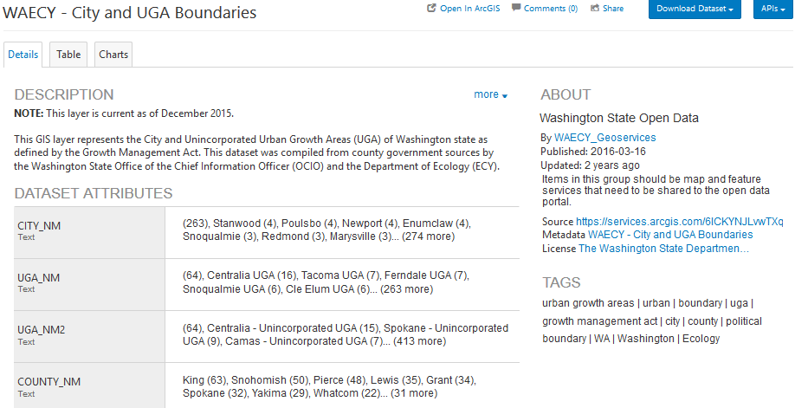
Examples – Mapping layers (Geo.wa.gov)

Slide 6
Examples – Open Checkbook (Fiscal.wa.gov)
How to use the tool
Filter data by Recipient, Agency, and/or Category by typing into the search boxes. Select multiple items in a filter
Graphical objects are interactive.
Charts allows for single or multiple selections.
Tabular Report can be sorted by any column by clicking on the column header.

Slide 7
Examples – Federal Data (Data.gov)
Over 198,023 datasets
13,857 state datasets
7,907 local government
It’s a catalog, not a repository

Slide 8
Examples – Data Refuge (DataRefuge.org)
DataRefuge helps to build refuge for federal data and supports climate and environmental research and advocacy. We are committed to fact-based arguments. DataRefuge preserves the facts we need at a time of ongoing climate change.

Slide 9
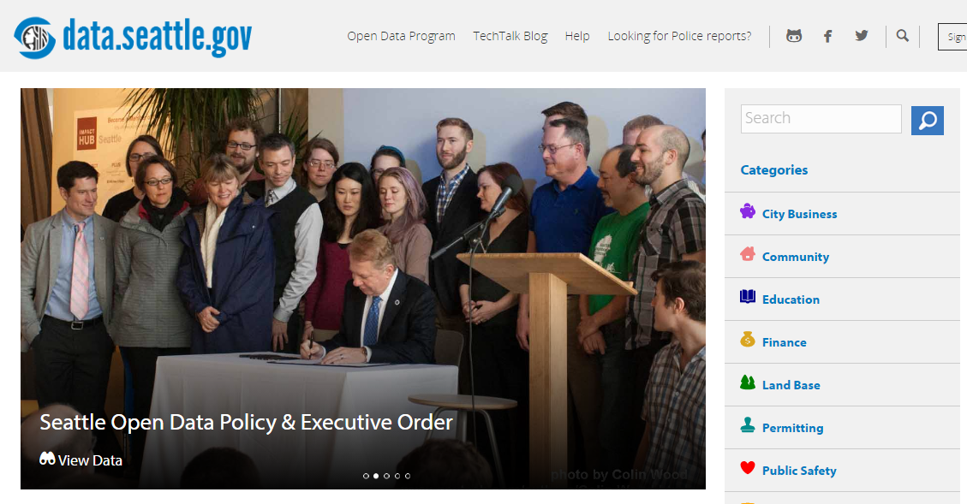
Notes:
Class 2b: The details behind the data #1a
Seattle Open Data a. Show slide with intro page: https://data.seattle.gov/

Slide 10
Some states centralize, WA collaborates
Transportation
Financial/Budget
Geospatial
Performance
General
Gov
General purpose: Data.wa.gov
LNI, DOH, OCIO
Geospatial: Geo.wa.gov
DNR, ECY, DAHP, WSDOT
Counties
Financial: Fiscal.wa.gov
LEAP, OFM, WSDOT
Performance: Results.wa.gov
60 agencies
Transportation: WSDOT.wa.gov

Slide 11
Users of Public Data – Civic Technologists
Hobbyist/Professional associations of developers
Builders of apps and prototypes
Hackathons
Meetups

Slide 12
Users of Public Data – Commercial Developers
Walkscore / Bikescore
“The Bike Lane Score is based on shapefile data provided to Walk Score by city governments. Bike lane infrastructure currently includes all on and off street bike lanes/paths but does not include infrastructure such as bike parking, bike sharing, etc.” https://www.walkscore.com/bike-score-methodology.shtml

Slide 13
Users of Public Data – Other Agencies
Spokane Community Indicators
The Community Indicators Initiative of Spokane seeks to improve local, private and public decision-making by providing relevant data in an easily navigable website. The data will serve neutral information for all parties involved.

Slide 14
Users of Public Data - Others
Open Data Impact Map
The Map includes organizations (companies, nonprofits, academic institutions and developer groups) that use open government data for advocacy, to develop products and services, improve operations, inform strategy and conduct research.

Slide 15
Legal Basis for (state) Open Data in WA
Legislative intent
RCW 43.105.351: “It is the intent of the legislature to encourage state and local governments to develop, store, and manage their public records and information in electronic formats to meet their missions and objectives. Further, it is the intent of the legislature for state and local governments to set priorities for making public records widely available electronically to the public.”
OCIO Powers and Duties
RCW 43.105.054: “The director shall establish standards and policies to govern information technology in the state of Washington.”
“The office shall: (a) Establish technical standards to facilitate electronic access to government information and interoperability of information systems, (b) Require agencies to include an evaluation of electronic public access needs when planning new information systems or major upgrades of systems.”

Slide 16
Benefits to Agencies
Web posting as complete response
RCW 42.56.520: “Within five business days of receiving a public record request, an agency, […] must respond in one of the ways provided in this subsection […]
(a) Providing the record;
(b) Providing an internet address and link on the agency's web site to the specific records requested
IT Decision Package Prioritization / budget review
Technology Strategy Alignment: The goal of these criteria is to assess the alignment of the IT proposal to the technology strategies of the state as articulated by the OCIO.
Mobility
Open Data
Modernization
Early Value Delivery

Slide 17
Constraints on Open Data
Lists of individuals for commercial purposes
RCW 42.56.070(8): “This chapter shall not be construed as giving authority to any agency, […] to give, sell or provide access to lists of individuals requested for commercial purposes…”
Accuracy, integrity & privacy
RCW 43.105.365: “To the extent possible, information must be collected directly from, and with the consent of, the individual who is the subject of the data.”
“…establishing mechanisms for individuals to review information about themselves and recommend changes in information they believe to be inaccurate…”

Slide 18
The Conundrum of Open Licenses
Many people and communities get sensitive about things like plagiarism, misquoting, blocking access by some people, altering the original meaning, or profiting from re-selling a free public resource
Open licensing helps break down barriers associated with traditional copyright by granting permission to use materials in advance.
Different types of subject matter (e.g. code, content, or data) are often times best served by different licenses to reflect their unique characteristics.

Slide 19
The Cornucopia of Open Licenses

Slide 20
Field Guide to Open data licenses – part 1
When you see: | It’s about | … and it basically means: | … with these notes and caveats
Creative Commons 0 Public Domain Dedication (CC0) | content, data | This license gives those who want to give up their copyright rights a way to do so, to the fullest extent allowed by law. Anyone can use the work in any way and for any purpose. Think of CC0 as the "no rights reserved" option. | CC0 is intended for use only by authors or holders of copyright, not for works already in the public domain. View Summary | View Legal Code
Open Data Commons Public Domain Dedication and License (ODC PDDL) | data | This license is intended for use on databases or their contents (“data”), either together or individually. The license allows you to freely share, modify, and use the data for any purpose and without any restrictions. | View Summary | View Legal Code
Creative Commons Attribution International (CC BY) | content, data | This license lets others distribute, remix, tweak, and build upon your work, even commercially, as long as they credit you for the original creation. | Recommended for maximum dissemination and use of licensed materials. View Summary | View Legal Code
Open Data Commons Attribution License (ODC-BY) | data | This license lets others share, produce works, modify, and build upon your database. You must attribute any public use of the database, or works produced from the database, in the manner specified in the license. | View Summary | View Legal Code
Adapted from Recommended Licenses by Open Definition | CC BY

Slide 21
Field Guide to Open data licenses – part 2
When you see: | It’s about | … and it basically means: | … with these notes and caveats
Creative Commons Attribution-ShareAlike International (CC BY-SA) | content, data | This license lets others remix, tweak, and build upon your work even for commercial purposes, as long as they credit you and license their new creations under the identical terms. | This license is often compared to “copyleft” free and open source software licenses. All new works based on yours will carry the same license, so any derivatives will also allow commercial use. View Summary | View Legal Code
Open Data Commons Open Database License (ODbL) | data | This license lets others share, produce works, modify, and build upon your database. You must attribute any public use of the database, or works produced from the database, in the manner specified in the license. | If you publicly use any adapted version of this database, or works produced from an adapted database, you must also offer that adapted database under this same license. View Summary | View Legal Code
Creative Commons Attribution-ShareAlike International (CC BY-SA) | content, data | This license lets others remix, tweak, and build upon your work even for commercial purposes, as long as they credit you and license their new creations under the identical terms. | This license is often compared to “copyleft” free and open source software licenses. All new works based on yours will carry the same license, so any derivatives will also allow commercial use. View Summary | View Legal Code
Adapted from Recommended Licenses by Open Definition | CC BY

Slide 22
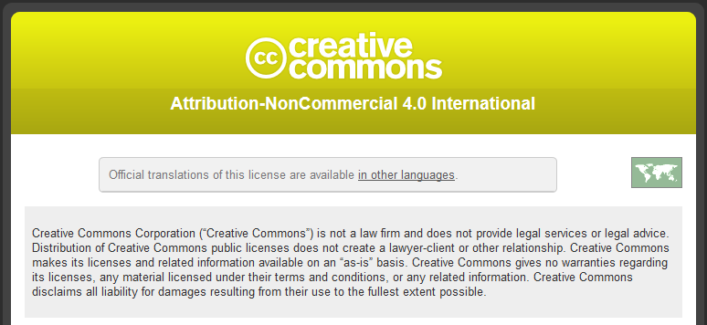
The Not-Quite-Open Licenses
CC-BY-NC (Creative Commons Attribution NonCommercial)

Slide 23
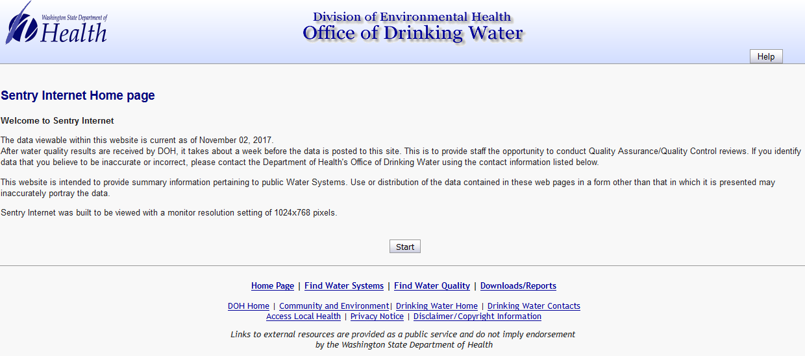
The Not-Quite-Open Licenses
Click-Wrap

Slide 24
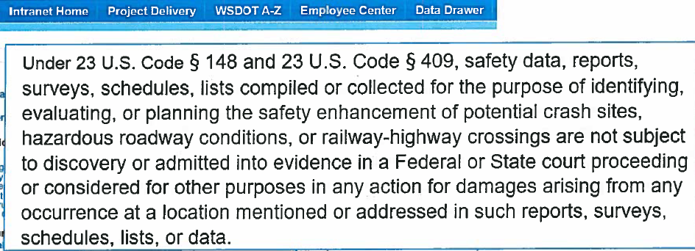
The Not-Quite-Open Licenses
23 U.S.C 148 + 409

Slide 25
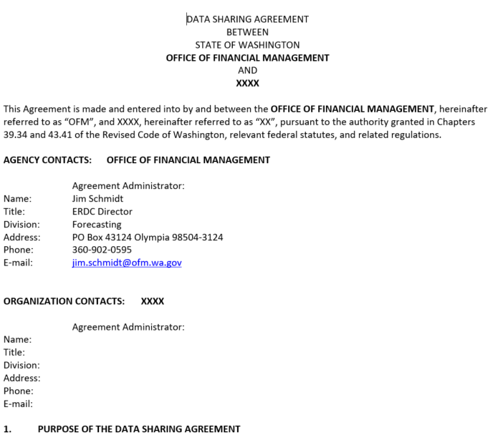
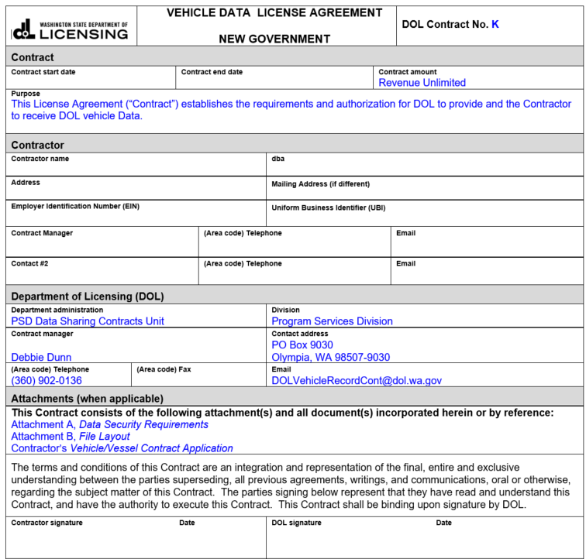
Specific Data Sharing Agreements / Licenses
Required (OCIO policy 141.10) for confidential data sharing
Multi-Agency Data Sharing Agreements working group
DOL updated templates and published lists
ERDC P-20 data sharing template and partners

Slide 26
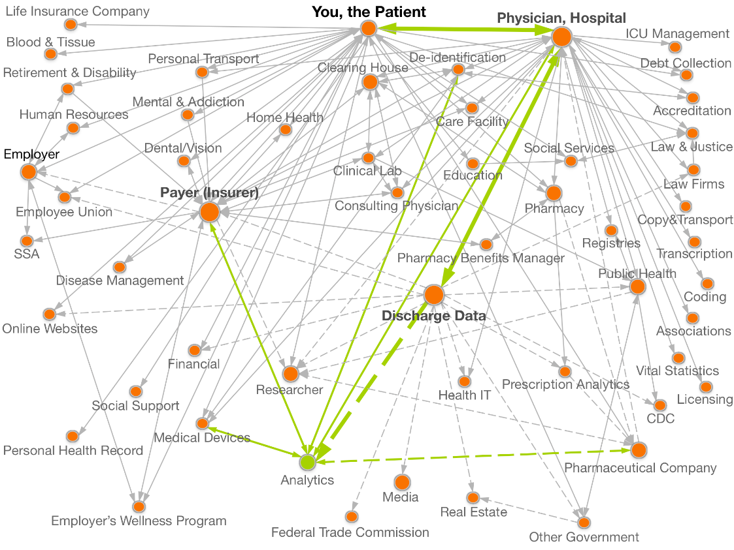
Crowdsourced data mapping
Undisclosed data sharing relationships exposed by researchers
theDataMap™ is an online portal for documenting flows of personal data. It tells you where your data goes. The goal is to produce a detailed description of personal data flows in the United States. The effort started with health data and is expanding to all other kinds of personal data. The motivation is to help journalists, advocates, regulators, policy makers and researchers undertand the current state of personal data sharing so they can do their jobs better. Our aim is to help the helpers.

Slide 27
Open Data
Will Saunders
OCIO / Office of Privacy and Data Protection
November 2017
Will.Saunders@ocio.wa.gov

Slide 28
Open Data – What is it?

