Slide 1
SIEC Meeting Thursday, June 18, 2020
State of Washington
State Interoperability Executive Committee

Slide 2
Call to Order & Introductions

Slide 3
Agenda For Review
Welcome and Introductions
Approval of December 2019 Meeting Minutes
New and Information Roundtable
DOC Relocation of Wireless Assets
SCIP Objectives
Drive-in WiFi Broadband Project
Good of the Order/Public Comments
Future Agenda Topics

Slide 4
Approval of December 19, 2019 Meeting Minutes

Slide 5
News & Information Roundtable

Slide 6
Washington State Department of Corrections (WADOC) Olympic Corrections Center
New License Request
Jose Zuniga
Electronic Security Systems Manager
WA Department Of Corrections
June 2020

Slide 7
Agenda
Agenda
Background
Research and Data
Conclusions and Next Steps
Questions & Comments

Slide 8
Background
WADOC is modifying an existing facility, the Olympic Corrections Center.
In support of this facility, frequencies must be licensed for communications.
WADOC intends to license two (2) 800 MHz OPS channels, in alignment with the frequencies in use at a number of correctional facilities.
WADOC also intends to license the 8TAC93 channel for interoperability as a control point.

Slide 9
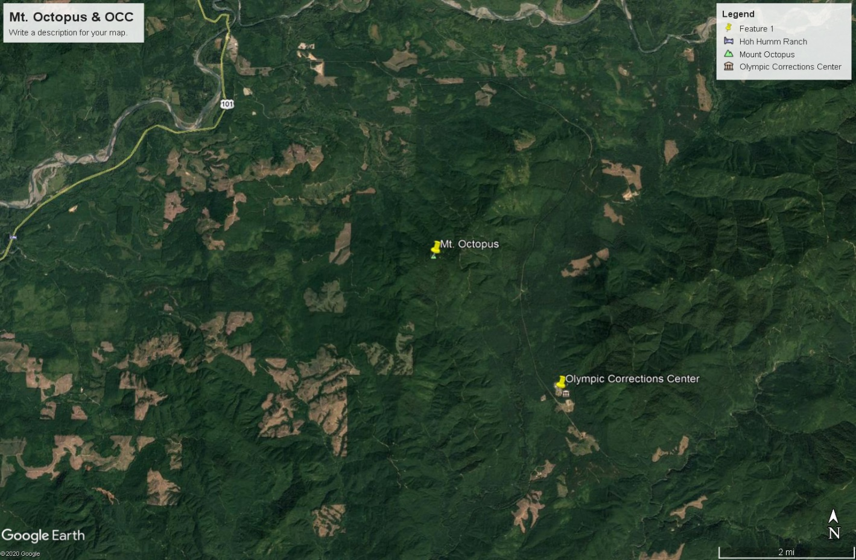
Relationship – Mt. Octopus and OCC

Slide 10
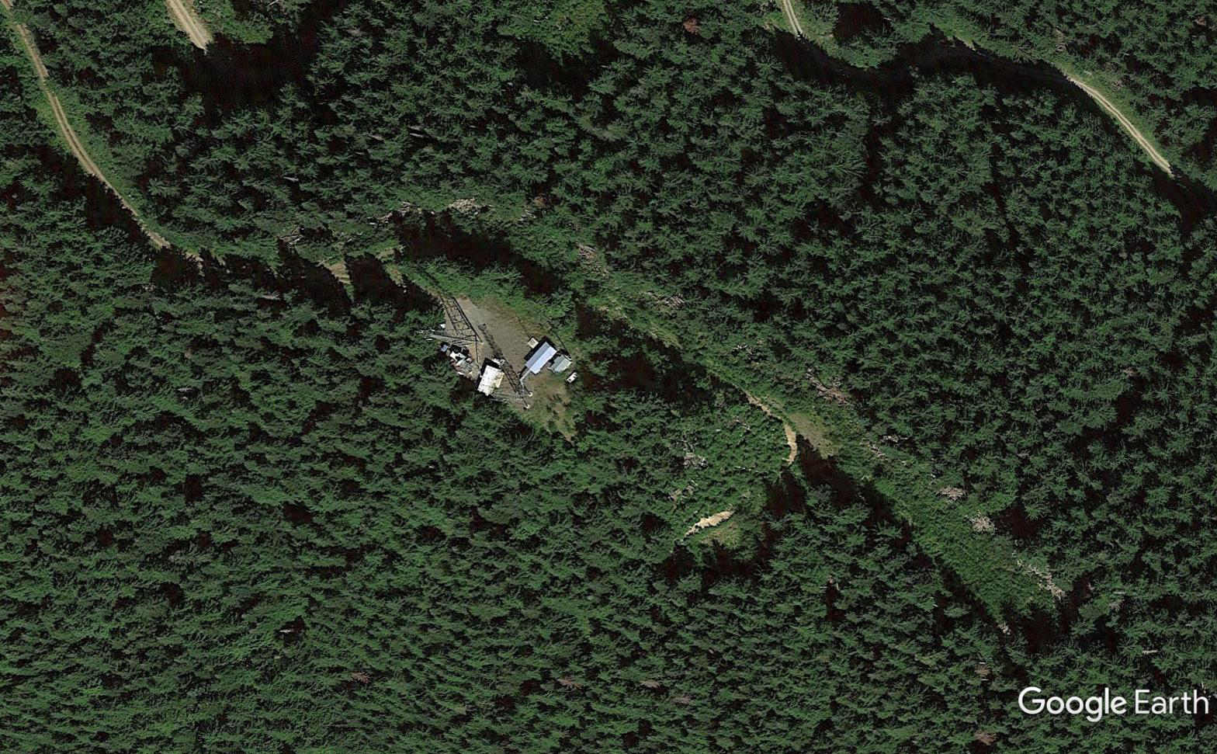
Background
Mt. Octopus
2318 feet AMSL

Slide 11
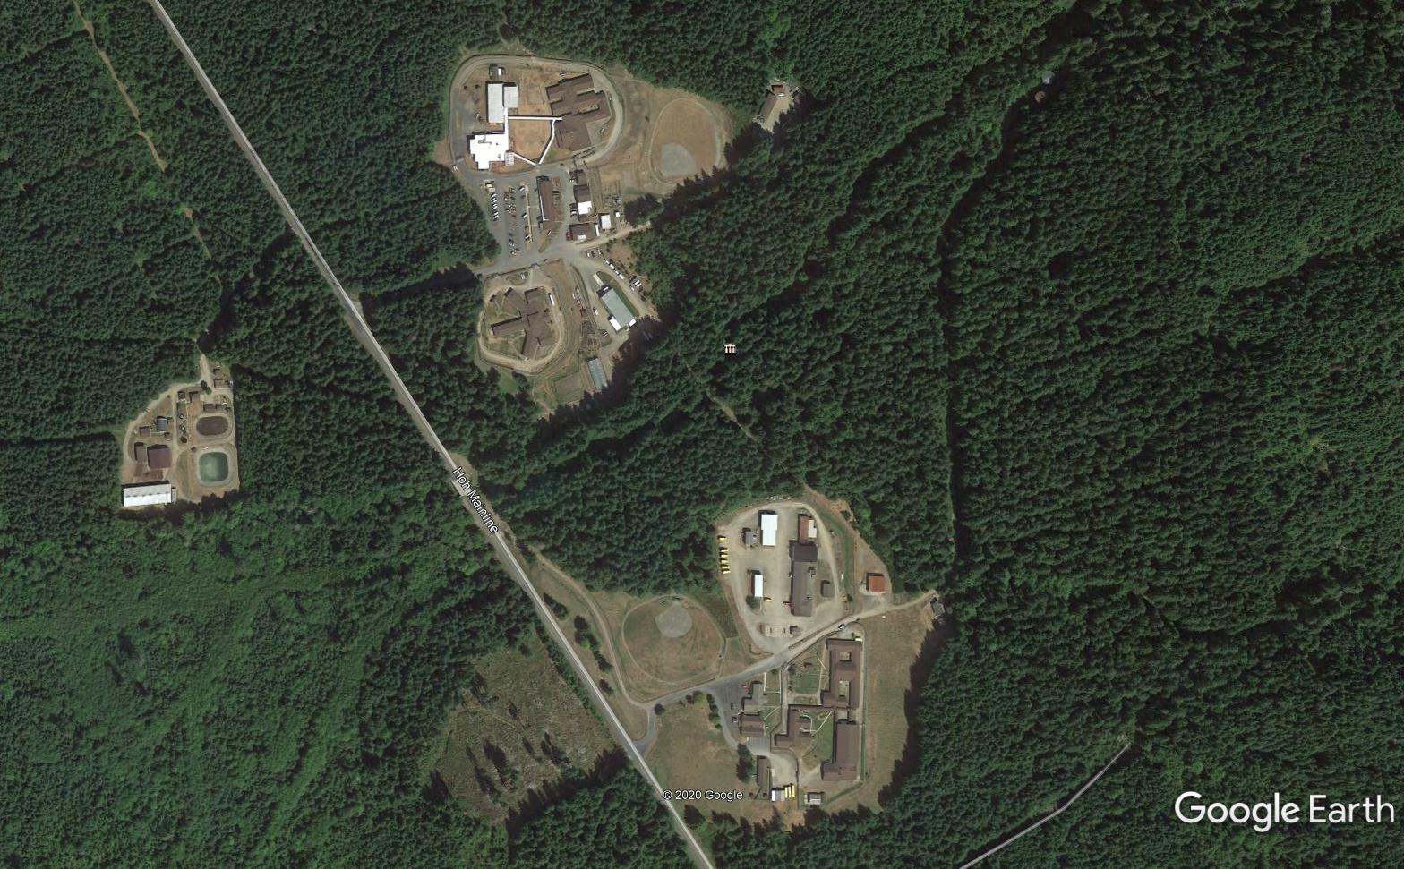
Background
Olympic Corrections Center
721.8 feet AMSL

Slide 12
Background
Licensing will include the following:
852.0625 MHz
will be licensed at OCC, along with associated mobiles.
856.5125 MHz
will be licensed at OCC, along with associated mobiles.
852.5125 MHz (8TAC93)
OCC will be added as a control point on call sign WPYH232.
853.1375 MHz
No changes proposed.

Slide 13
Background
Proposed Licensed Location:
Frequencies to be licensed will operate per the following:
Address: Olympic Corrections Center
11235 Hoh Mainline Forks, WA 98331
Latitude: 47 – 43 – 07.7 North
Longitude: 124 – 08 – 11.2 West
Elevation (AMSL): 220.0 meters / 721.8 feet
Antenna Height: 26 meters / 85.3 feet
The area of operation for the frequencies in use is a 5-kilometer radius around the proposed licensed location (above).

Slide 14
Research and Data
Incumbent Co-channel Users within 128 km (80 miles) of proposed new location:
Research Table – Co-channel Licensees within 88 km
Call Sign | Licensee Name | Loc # | Latitude | Longitude | AMSL m | Ant Ht m | Ant Type | ERP W
Olympic CC | WA DOC Proposed | 1 | 47-43-07.7 N | 124-08-11.2 W | 220.0 | 30.0 | Omni | 250
WPKU671 | WA DOC | 1 | 47-44-55.3 N | 124-10-35.7 W | 705.0 | 15.0 | Omni | 150
WPHR517 | WA DOC | 1 | 47-20-51.3 N | 122-36-41.5 W | 98.0 | 18.0 | Omni | 75
WPHZ896 | WA DOC | 1 | 47-14-28.3 N | 123-11-30.6 W | 90.0 | 15.0 | Omni | 75
WPKU655 | WA DOC | 1 | 46-53-05.4 N | 123-08-48.5 W | 207.0 | 12.0 | Omni | 74
WPKU670 | WA DOC | 1 | 48-14-19.3 N | 124-17-29.8 W | 134.0 | 15.0 | Omni | 317
WQXU832 | WA DOC | 1 | 47-29-02.0 N | 122-51-13.0 W | 137.0 | 18.2 | Omni | 33.9
There are no 12.5 KHz adjacent channel users identified within the search radius.

Slide 15
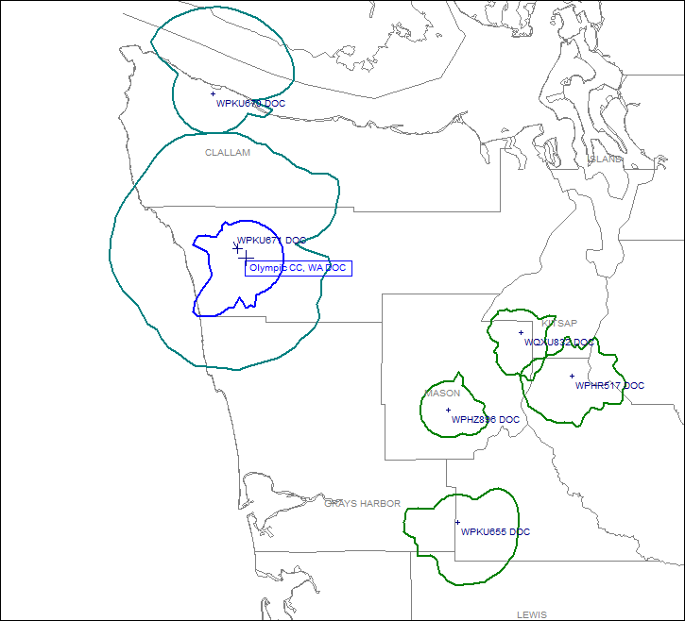
Research and Data
Only co-channel licensee within 80 miles is WADOC.
Legend:
Green – Incumbent 40 dBu service contour
Blue – Proposed 40 dBu service contour

Slide 16
Conclusions
OCC is at a significantly lower elevation than Mt. Octopus. As such, proposed 40 dBu service contours are smaller than the existing service contours.
Only co-channel licensee within 80 miles is WADOC.
Requested licensing modification will have no adverse affect on any licensee in the region.
WADOC requests an approval from WA SIEC to license frequencies at the Olympic Corrections Center.

Slide 17
Questions, Comments?

Slide 18
SCIP Objectives Jose Zuniga, DOC Richard Hall, MIL

Slide 19
SCIP Objectives
SCIP Objective 4.1 – Update on the public safety agencies in the state inclusion for the Field Operations Guide (FOG) - Richard Hall (MIL)
SCIP Objective 4.2 – Collect data to develop an interoperability map - Jose Zuniga (DOC)
SCIP Objective 4.3 – CASM update - Jose Zuniga (DOC)
SCIP Objective 5.1 – Collect data for state agencies – what assets to collect data on (Deployables or Full inventory) - Jose Zuniga (DOC)

Slide 20
Washington State Broadband Office
2020 Drive-In WiFi Hotspots Project
Russ Elliott
Director, Washington state broadband office
06/18/20

Slide 22
The Challenge
March 2020
COVID-19 Emergency highlights need for statewide public access to Drive-In WiFi Hotspots for Telehealth, Remote Learning, Telework, Unemployment Filing, and Census Participation
Genesis of WiFi hotspot initiative by André-Denis Wright, Dean, College of Agricultural, Human and Natural Resource Sciences, Washington State University
Initial scope proposed 40 Washington State University Extension offices
Expanded scope resulted in three-phase public-private collaboration: PI) +15 WSUE/WSL sites; PII) +30 WSUE sites; PIII) +200 new and 320 pre-existing sites

Slide 23
The Collaboration
Washington State University Extension (Phase I-II installation)
Washington State Library, a division of the Washington Secretary of State
Department of Commerce
NoaNet (Phase III Project Management Lead - volunteer)
Information Technology Disaster Resource Center (Phase III equipment and installation donation)
Internet Service Providers
Washington Independent Telephone Association
Public Utility Districts
Port Districts
Office of Public Instruction and School Districts
Washington Universities
Washington Community and Technical Colleges
Private retail and service businesses
Washington Technology Solutions
Emergency Support Function #2
Microsoft (Phase I funding)
Washington State Office Of The Governor (Phase II funding)
Avista Foundation (Phase III funding contribution)

Slide 24
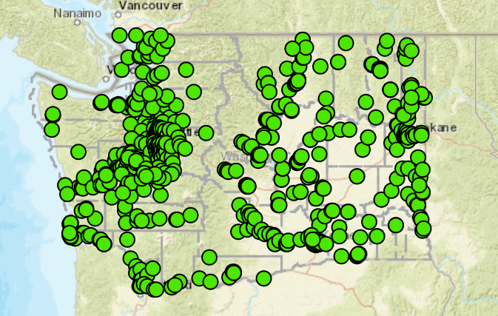
The Result
April-June 2020
567 Drive-In WiFi locations
Online location finder www.driveinwifi.wa.gov
47, 281 map dashboard hits
New locations go live weekly

Slide 25
Thank you!
Russ Elliott
Director, Washington state broadband office
Russ.Elliott@commerce.wa.gov
564-999-0326

Slide 26
Good of the Order/ Public Comments Next Meeting: August 20, 2020 Location: Virtual or 1500 Jefferson St. SE 1st Floor Presentation Room (1213) Olympia, WA

