Slide 1
ITS Communications & Wireless LMR System Replacement
SIEC Update
Tim McDowell
ITS Communications Manager
John Nisbet
Director Traffic Operations
February 21, 2019
Roger Millar, Secretary of Transportation
Keith Metcalf, Deputy Secretary of Transportation

Slide 2
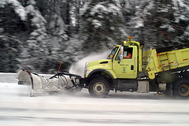
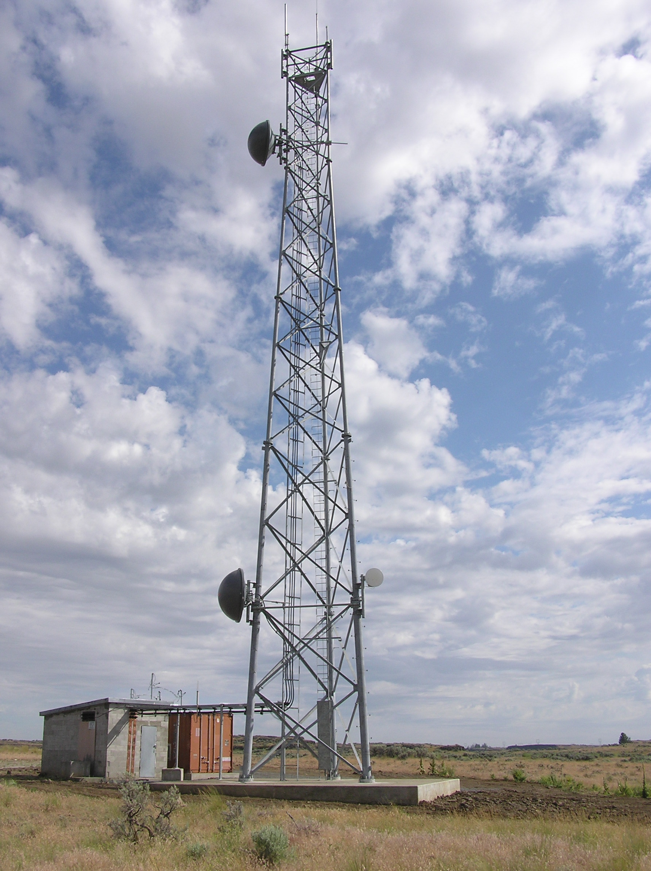
Progress to date
FCC licensing is complete.
First milestone system design review is complete.
OCIO security design review is complete and approved.
Site visits for 2 regions are complete.
Schedule shifted during system design review.
Some pilot and regional deployment activities are compressed to meet the agency goal of completing 2 regions before December of 2019. Mainly to ensure we have spare parts going into that winter season.
Final region complete is still December of 2021
Detailed design review for the 13 pilot sites is complete.
Factory acceptance for pilots competed this week

Slide 3
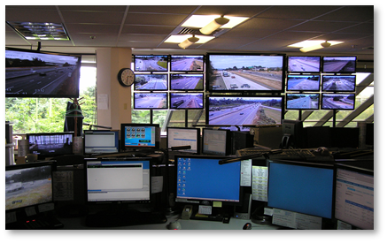
Upcoming tasks
Maintain OCIO IT Pool Dashboard
Scope
Schedule
Budget
OCIO Assessment
Current status and quality assurance reports on the OCIO Dashboard.
Complete detailed design for Northwest and North Central regions.
Install equipment for pilot and conduct pilot testing.
Factory acceptance and equipment delivery for remaining sites in Northwest and North Central regions.

Slide 4
Schedule

Slide 5
Schedule

Slide 6
Questions?
Tim McDowell
Washington State Department of Transportation
ITS Communications & Wireless Technology
mcdowet@wsdot.wa.gov
(360)705-7028

