Slide 1
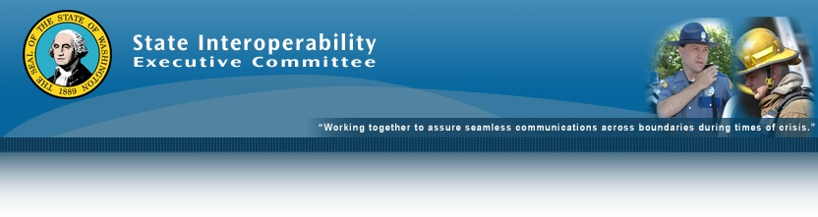

Federal Interoperability Frequencies Licensing Request
State Interoperability Executive Committee (SIEC)
February 21, 2019
Bob Schwent
WSP Electronic Services Division
Washington Statewide Interoperability Coordinator

Slide 2
Request Background
The National Telecommunications and Information Administration (NTIA) manages the use and licensing of radio spectrum by federal agencies. The Federal Communications Commission (FCC) manages the use and licensing of radio spectrum by non-federal organizations and agencies.
State and local agencies may use some federal spectrum in limited situations for interoperability. This spectrum is generally designated as national interoperability channels.
There are radio frequencies set aside for national interoperability between agents of the U.S. Federal Government for Interagency Law Enforcement and Incident Response operations.
Before operating on federal government interoperability frequencies, a non-federal user agency must apply for and be granted a license by the FCC to operate on specified federal government interoperability frequencies. Each application to the FCC shall be accompanied by a concurrence letter from the SWIC, his/her designee, or a state appointed official. A state agency may apply for a license which authorizes mobile and portable units to operate statewide on the Federal Interoperability Channels. Upon grant of the application, local and tribal agencies may operate under the state agency’s call sign pursuant to 47 CFR § 90.421.

Slide 3
Conditions of Use
These channels are available for use among federal agencies and between federal agencies and non-federal entities with which federal agencies have a requirement to operate.
These channels are available to non-federal entities to enable joint Federal/non-federal operations for law enforcement and incident response, subject to the condition that harmful interference will not be caused to federal stations.
These channels are restricted to interoperability communications and are not authorized for routine or administrative uses as defined by the NTIA Manual.
Extended operations and congestion may lead to frequency conflicts. Coordination with NTIA (through the sponsoring Federal agency) is required to resolve these conflicts.
Only narrowband emissions are to be used on the Federal Interoperability Channels.
This MOU does not authorize the provisioning or use of the frequencies listed in Appendix A in any permanent infrastructure.

Slide 4
Licensing Request
The Washington State Patrol signed a Memorandum of Understanding between the State of Washington and the U.S. Department of the Interior (US DOI) October 1, 2018 regarding the use of these frequencies.
Washington State was the 17th state to enter into this agreement, and has the second most restrictions due to Canadian spectrum use, behind only New York.
WSP seeks to license these interoperability frequencies with the FCC on behalf of the State of Washington. Details are on the next slide.
Use of these licenses will be granted to local and tribal agencies through the Statewide Interoperability Coordinator in accordance with the FFC and NTIA agreement and the requirements of the MOU between WSP and US DOI.

Slide 5
Licensing Request

Slide 6
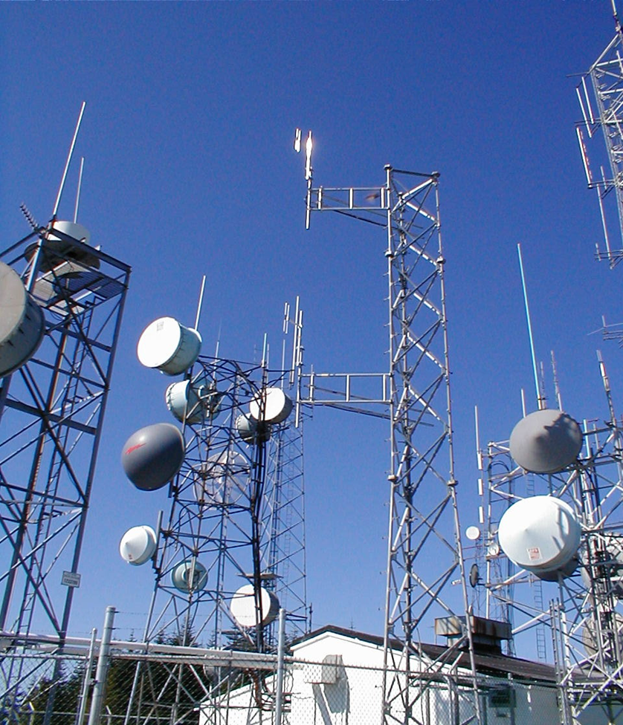
Questions?
Bob Schwent
(360) 534-0601
Robert.schwent@wsp.wa.gov

