Slide 1
SIEC Meeting
Thursday, December 17, 2015
State of Washington
State Interoperability Executive Committee

Slide 2
Introductions

Slide 3

Welcome!
Keith Flewelling

Slide 4
Agenda
Welcome and Introductions
News and Information Roundtable
Public Comment
Update on Communications Order Model Practice for Radio.
Washington OneNet / FirstNet In Washington
  Outreach Activities
  Timeline – Ours and FirstNet’s
Phased Development of FirstNet
Ongoing Projects
Good of the Order
Review, modify this agenda?

Slide 5
Approval of October, 2015
Meeting Minutes + Bullet Points

Slide 6
News and Information Roundtable
Public Comment

Slide 7
Update: Communications Order Model Practice for Radio
Jim Sharp
Wayne Senter

Slide 8
Washington OneNet and FirstNet Updates
Shelley Westall

Slide 9
Date | Activity | Status
January 13 | FirstNet issues RFP. | Completed
January 28 | OneNet conduct F2F strategic planning mtg. with MIL/EMD, Contractors & FirstNet | Initial survey results submitted to FirstNet
January | Work on Active Shooter Video Begins | Ongoing
February | Discovery Work on Wildfires video begins | Ongoing
 | ATNI passes Resolution 16-17 requesting continued funding for OneNet from the Federal & State Gov’t | Completed
February26-29 | West Region EMS Washington State Fire Training @ Safety Officers Senate Tribal Broadband workgroup American Indian Lobby Day | Completed
March 2 | Idaho’s FirstNet Consultation & Regional Coverage Planning | Completed
 | Stevens County Broadband Action Team | Ongoing
March 21-25 | IWCE – OneNet moderated 1 panel and presented at 5 sessions. | Completed
April 12-13 | National SPOC Meeting | Completed
TBD | FirstNet Applications Workshop Cascadia Tabletop Devices Workshop | Planning underway
TBD | Regional Planning | Ongoing
2016 Activities

Slide 10
OneNet Activities since October SIEC Meeting
OneNet Data Collection and Coverage Mapping Workshops - Completed
    FirstNet 201: Omak, Colville
Tribal Outreach meetings: Colville and Spokane Tribes
OneNet Stakeholder Meeting 10/27 and 10/28
Infrastructure Assistance Coordinating Council October 20-22
FirstNet Applications Workshop November 3-5
Northwest Tribal Technical Assistance Workshop November 17
WSAC County Leaders Conference November 17-20
WASPC Fall Conference November 16-19
“After Oso” Video to be released October 26, 2015
“FirstNet in an Active Shooter Situation” Video Underway

Slide 11
Activities coming up in 2016:
OneNet Planning and Strategy meeting with extended consultant team
      Late January
ATNI Winter Convention
  February 1-4 - Suquamish
West Region EMS Conference
      February 20-22 – Ocean Shores
APCO West Region Conference
      March 3-10 - Portland
IWCE 2016 Conference
      March 21-25

Slide 12
2016-2017 Anticipated Activities
Date | Washington OneNet | FirstNet
Early 2016 | Statewide Mtg FirstNet – HOW? | Same
2016 | Work on State Plan: coverage, phased deployment, who to use Continue, improve data about agency use Apps workshops, Cascadia Rising | Work with Washington on State Plan
June, 2016 |  | RFP Responses received; evaluation starts
Early 2017* |  | Vendor(s) Chosen
2017* | Work with Stakeholders, FirstNet on State Plan | Fold vendor response into State Plan
2017* |  | Finalize State Plan
Late 2017* | Review State Plan; to Governor | State Plan to Governor
Red = SIEC Discussion

Slide 13
Phased Development of FirstNet
State Plan Approval Process
Bill Schrier

Slide 14
Schrier’s Timeline Guesstimate
Sept. 30 Data to FirstNet for RFP
(survey info, coverage, etc.)
Dec. 31 FirstNet Issues RFP
May 31, 2016 RFP Responses Back
2017? RFP Vendor(s) Chosen by FirstNet
2017 Fold RFP Vendor’s response and detailed
requirements into State Plan
Q1 2018? FirstNet plan to Governor for Opt-in/out
2018? Deployment Begins
Not Official
Notes:
Dec. 31 and May 31 dates are hard and fast according to FirstNet. We’ll see.

Slide 15
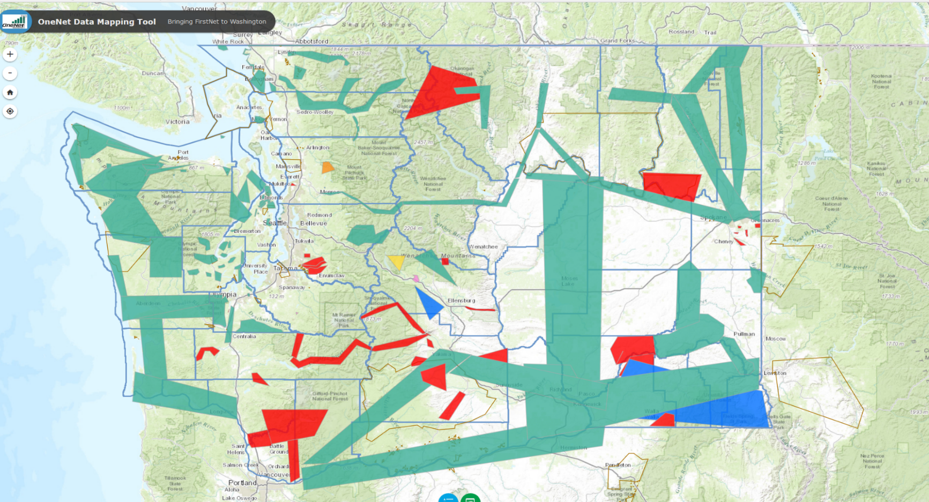
Coverage Mapping

Slide 16
Coverage
Input for the FirstNet RFP
Suggestion:
  Rapid Deployment on Vendor’s Proposed sites
  Robust deployables strategy: existing comm vehicles, COWs, drones, balloons, etc.
  All U.S. and State Highways
Alternatives?

Slide 17
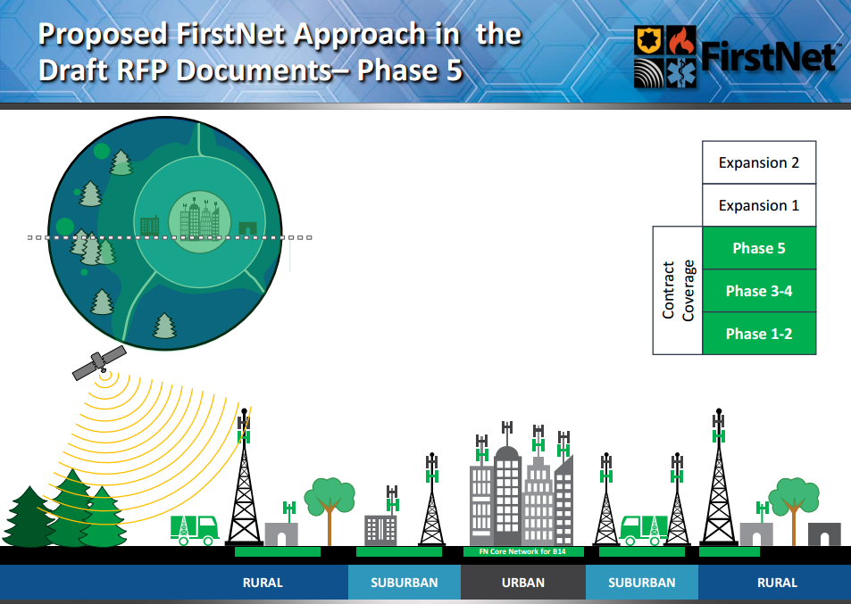
FirstNet Phased Deployment

Slide 18
Phased Deployment
FirstNet: 5 phases, starting with urban
OneNet: The whole state needs to be covered, as rapidly as possible
See also coverage suggestions
Alternatives?

Slide 19
State Plan Approval Process (2018?)
Stakeholder, Operational, & Technical Committees engage FirstNet and Vendor to develop State Plan
Committee recommendations go to SIEC
SIEC to review State Plan and vote on whether is meets the state’s needs
FirstNet sends State Plan to Governor
SIEC, Stakeholders, tribes provide feedback to Governor on merits of the State Plan

Slide 20
FirstNet – OneNet Survey of Responders
(conducted by WSU/DGSS)
Bill Schrier
WSU Team Members

Slide 21
OneNet/FirstNet Data Survey
Purpose: provide data for FirstNet’s RFP (due out early January, 2016)
Conducted by Washington State University Division of Government Studies/Services
Anonymous
Statistically valid
Dr. Season Hoard
Results still in draft
Agencies can still respond

Slide 22
Survey Results Overview
923 survey invitations, 173 agency responses
    79 law enforcement (45.9%) of 260
    62 firefighting (36.0%) of 410
    Transportation, life-line infrastructure, etc.
    26,852 employees total
      Law Enforcement: 10,376 of 17,602 employees
      Firefighting: 3,686 employees of 21,795 (Career: 9,322)
      Other: 12,790 employees
    12,936 devices (personnel)
    5,889 devices (vehicles)

Slide 23
Survey Results Services
66.5% use Verizon as a provider
57.9% very important to have fixed rate plan
62.4% have unlimited data plans
55.1% spend $25-$49 a month for data
23.4% spend $50-$74 a month for data
Barriers: 47.3% cite coverage as a problem
Barriers: 27.1% cite budget

Slide 24
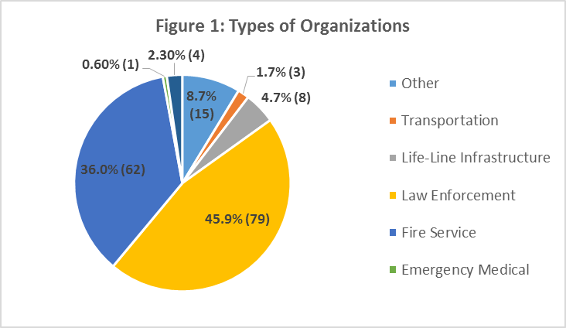
Law Enforcement: 260 agencies; Firefighting: 410 agencies

Slide 25
Urban and Rural
Type | Agencies | Employees | Volunteers | Devices
Urban | 96 | 24,192 | 2,338 | 12,020 – 5,512
Large Rural | 25 | 1,513 | 710 | 385 – 245
Rural | 39 | 647 | 813 | 531 – 124
Type | Agencies | Employees | Volunteers | Devices
Eastern WA | 28 | 1,189 | 507 | 867 – 359
Central WA | 28 | 1,265 | 697 | 594 – 131
Puget Sound | 65 | 18.733 | 1,338 | 10,702 – 3,899
Coastal, SW WA | 39 | 5,124 | 1449 | 1,021 – 1,476

Slide 26
“Aha” Results
71.4% of agencies allow use of personally owned devices for work (BYOD) but most (71.9%) do not provide compensation
91.3% use wireless data – but probably under-representing many rural departments

Slide 27
Uses of Wireless Data
  general connectivity (91.3%, 157),
  communications (87.5%, 147)
  computer aided dispatch (78.7%, 133)
  database inquiries (69.8%, 118)
  voice (57.1%, 96)
  intranet access (57.3%, 98)
  field based reporting (55.6%, 94)
  location services (54.4%, 93)

Slide 28
Comparisons
 | Fire Service | Law Enforce-ment | Other Respond-ents
Allow personal devices | 88.3% | 57.7% | 75%
Paging Systems | 82.3% | 17.7% | 29%
Auto. Vehicle Location (AVL) | 21% | 43.6% | 40%

Slide 29
Contrasts
  Rural and Urban: coverage, use
  Puget Sound and others: BYOD, use of AVL, field reporting, VPN, budget to purchase

Slide 30
Next Steps?
  Encourage more participation, especially rural, tribal
  Finalize the existing analysis report
  Socialize results with associations
    Contact respondents with results
    Would you like a slide deck to do so?
  Future surveys?
    Drill down into apps in use

Slide 31
Washington State Patrol Narrowbanding Project Status
Bob Schwent

Slide 32

WSP Narrowbanding Project
State Interoperability
Executive Committee (SIEC)
~ December 17, 2015 ~
Bob Schwent, WSP Electronic Services Division
Statewide Interoperability Coordinator

Slide 33
WSP District Map

Slide 34
P25 Narrowband Project
Major Tasks Completed or In Process
District 1 (Tacoma) is pending
  700 MHz trunked site addition (Olympia area)
  Agreements in process for interface with Pierce County talk groups (Tacoma)
District 2 (Bellevue) implementation is complete
  North Bend site addition – remediation of issues at I-90 and SR18 intersection
District 3 (Yakima) implementation is complete
District 4 (Spokane) implementation is complete
District 5 (Vancouver) implementation is complete
District 6 (Wenatchee) is pending
  Wideband – Narrowband impact analysis is underway
District 7 (Marysville) implementation is complete

Slide 35
P25 Narrowband Project
District 8 cutover delayed
Coverage concerns in key areas will require mediation
  Neilton site addition – communications enhancement
  Cosmopolis site relocation – narrowband impact remediation
  Minot site addition – narrowband impact remediation
District 2 coverage mitigation
North Bend area coverage issues
  Installation of a new base station to cover the area of the I90 – SR18 interchange area is pending
District 1 (Olympia) 700MHz expansion
Long standing coverage problems in the Olympia / Shelton areas
  Will be addressed prior to cutover of District 1
  Possible addition of a 700MHz trunked site at Maxwell Hill

Slide 36
P25 Narrowband Project
Next Steps
District 1
  Finalize agreements with Pierce County
  Design and install trunked site for Olympia area coverage enhancement
  Draft District Cutover Expectation Approval Document for District Commander approval
  Planning meetings with district leadership
District 6
  Continue wideband analog/narrowband analog conversion assessment, and remediation (if necessary)
  Conduct initial planning meetings with district leadership
  Draft Cutover Expectation Approval Document for Commander and Sponsor approval
  Begin detailed cutover planning
District 8
  Draft updated Cutover Expectation Approval Document for Commander and Sponsor approval
  Install new sites
    Neilton (new)
    Minot (new)
    Cosmopolis (relocation)
  Refresh pre-cutover tasks
Performance to Budget

Slide 37
P25 Narrowband Project
Project Issue Pace-Setters
Project Pace-Setters | Risk to the Project | Notes
Budget Availability |  | Project budget is at risk due to increases in scope for D1 and D8, and to address risk in D6.
Human Resource Availability |  | Close management has mitigated the impact of resource constraints to the project schedule.
Schedule Stability |  | The schedule has slipped and will be re-baselined based on increases to project scope for D1 and D8. D6 remains a risk.
Scope Management |  | Project scope has expanded due to new requirements in D1 and D8. D6 remains a risk.
Technology |  | FCC site license update paces D7 cutover schedule.
Coverage Survey Progress |  | District coverage surveys are now moving ahead of the project schedule.
Training Progress |  | District leadership continues to take the lead and ownership over Trooper training.

Slide 38
P25 Narrowband Project

Slide 39
Interoperability Efforts
Advanced System Key sharing agreement with Pierce County CCN awaiting signature.
Advanced System Key sharing agreement with City of Tacoma under city review.
Advanced system Key sharing agreement in progress for City of Seattle system. Cross programming has begun on WSP portables.
WA Tactical Interoperable Communications Field Operations Guide (TIC-FOG) kickoff meeting held.

Slide 40

Questions?
Bob Schwent
Robert.schwent@wsp.wa.gov
(360) 534-0601

Slide 41
800 MHz Rebanding Project
Michael Marusich

Slide 42
800 MHz Project Status
WSDOT
  Three sites remain to complete WSDOT Rebanding infrastructure reconfiguration -
    Striped Peak: Transition Administrator (TA)-provided replacement frequencies deemed acceptable; reconfiguration schedule pending.
    Gold Mountain: One replacement frequency deemed acceptable; TA researching alternative replacement for second frequency.
    Dodge Ridge: Winter Operations restrict ability to reconfigure site until second quarter 2016.
  Anticipating reconfiguration completion 90 days after last site.
WADOC
  WADOC facility infrastructure reconfigurations are complete.
  Specialty teams, transportation units and community team radios remain to complete reconfiguration efforts (Est: January 2016).

Slide 43
SIEC Advisory Work Group
(SAW)
Michael Marusich

Slide 44
SAW Report – December 2015
Field Operations Guide (FOG) Development –
  WA SWIC (Schwent – WSP) submitted a Technical Assistance (TA) request to Dept. of Homeland Security (DHS) Office of Emergency Communications (OEC) to assist in assembling a statewide Washington Homeland Security Region-based Tactical Interoperable Communications (TIC) Field Operations Guide (FOG) or “TIC-FOG”.
  MIL (Benavente) and WA OneNet (Osborn) collaborated to invite WA radio system operators to the initial TIC-FOG development working session on December 10th in Olympia.
  A systems information collection sheet was distributed to system operators in advance of the working sessions.
  Anticipated deliverables include a single hard copy of the WA TICFOG and the associated print-ready Word file, and an on-line e-TICFOG – usable without Internet connectivity.

Slide 45
Future Agenda Topics
TBD
TBD
2018
Air- to- Ground Channels
Follow up on SR530 Landslide Recommendations
Review and Recommendation to Governor on the State Plan for FirstNet

Slide 46
Good of the Order
Next Meeting: February 18, 2016
Location:
Camp Murray, WA

