Slide 1
SIEC Meeting
Thursday, June 16, 2016
State of Washington
State Interoperability Executive Committee

Slide 2
Introductions

Slide 3
Agenda For Review
Welcome and Introductions
Approval of April Meeting Materials
News and Information Roundtable
Public Comment
SIEC Legislative Changes
Washington OneNet / FirstNet In Washington
Systems Procurement Updates
Ongoing Projects
Good of the Order
Modify this agenda?

Slide 4
Approval of April 21, 2015
Meeting Minutes
+ Bullet Points

Slide 5
News and Information Roundtable
Public Comment

Slide 6
SIEC Legislative Changes
Bill Schrier

Slide 7
Proposed Changes to SIEC
RCW 43.105.331
“Interoperability is about mobile data too”
Add membership:
  Department of Corrections
  Department of Health
  Department of Fish and Wildlife
  Tribal nations representative
  Public Safety Answer Points representative (APCO/NENA)

Slide 8
Proposed Changes to SIEC
RCW 43.105.331
Authority for Standards and Policies
Interop of mobile data devices, apps
Standardize apps for interoperability
Monitor FirstNet deployment
Software and devices for Internet of Things (IoT)
Cybersecurity, privacy, interoperability
Other/thoughts?

Slide 9
Public Safety Wireless Technology Program
Probably not in RCW
Public Safety Office/Program in WaTech
Apps catalog, usability evaluations, network/app performance, cybersecurity eval, app development and support, economic development, academic research, apps for citizens, changes operational processes, regional co-op

Slide 10

Washington OneNet Update
Shelley Westall

Slide 11
Upcoming Outreach Activities 2016:
06/07-09/16 Public Safety Communications Research (PSCR) program Stakeholder Meeting
06/27-30/16 National Congress of American Indians Mid-year conference
06/22-24/16 APCO-NENA Summer Conference
07/28/16 7th Bi-Annual NW Alcohol Conference
08/04/16 Regional Consultation Task Team Meeting
Planned:
Texas Early Builder Demonstration Visit – Week of August 28, 2016
FirstNet Applications Workshop – Sept 2016
FirstNet Devices workshop – Early 2017
Cascadia Rising Communications
Tabletop Exercise – Fall 2016

Slide 12
Other Activities:
State/Regional Plan Expectations - Ongoing
    What do Washington Stakeholders and Regional partners require of a nationwide public safety LTE broadband network
  Consultation Task Teams (CTT) / Quality of Service, Priority and
  Preemption (QPP) Workshop – May 31 and regional on August 4
      FirstNet’s goal for CTT/GPP: . . “enable subject matter experts from each state and territory to inform the network’s QPP policies.”
  Texas Early Builder Demonstration Visit – Week of August 28
      Demonstration of an LTE broadband network operating on Band Class 14 spectrum.

Slide 13
Outreach Milestones: April – June 2016
Stakeholders Engaged: | April-June | Since 2013
Twitter Reach: | 13,507 | 170,224
Facebook: | 1,739 | 18,999
GovDelivery: | 14,980 | 83,399
Web Stats: | 1,816 | 7,485

Slide 14

Other Milestones:
Washington OneNet is awarded two Bronze Telly Awards
Government Relations Category:
      After Oso
      Information Category:
      Bringing FirstNet to Washington State
      The Telly Awards honors the very best film & video productions, groundbreaking online video content, and outstanding local, regional, & cable TV commercials and programs.

Slide 15
System Procurement Updates:
WSDOT
DNR
DFW
Corrections
Counties/other

Slide 16
Ongoing Projects:
Washington State Patrol Narrowbanding Project Status
Bob Schwent

Slide 17

WSP Narrowbanding Project
State Interoperability
Executive Committee (SIEC)
~ June 16, 2016 ~
Bob Schwent, WSP Electronic Services Division
Statewide Interoperability Coordinator

Slide 18
WSP District Map

Slide 19
P25 Narrowband Project
Major Milestones
District 2 (Bellevue) – complete
District 3 (Yakima) – complete
District 4 (Spokane) – complete
District 5 (Vancouver) – complete
District 7 (Marysville) – complete
District 8 (Bremerton) – complete
District 1 (Tacoma) – in progress, completion scheduled for August 9
District 6 (Wenatchee) - pending
  Early subscriber reprogramming plans are in process
  Wideband – narrowband impact assessment is pending
  Site readiness assessments are in process

Slide 20
P25 Narrowband Project
District 1 Efforts
ISSI connection between Pierce CCN and WSP
  Primarily for Communication Center awareness
  CCN is ISSI8000, WSP is ISSI.1
  First ISSI connection for WSP
Maxwell site addition
  6 channel TDMA 700MHz trunking
  Provides coverage in the SR101, SR3, and SR8 areas
Subscriber programming
  Includes Pierce CCN and Tacoma/Puyallup talkgroups
  SR410 Simulcast added
WSP talkgroups on Pierce CCN system for primary dispatch
  Emergency Calls will be present in both communication centers
  Increased coverage and capacity for WSP
  Unsurpassed Interoperability for all LE agencies in Pierce County

Slide 21
P25 Narrowband Project
Outstanding Issues
District 8
Portable Coverage in Kitsap County
  Portable coverage was very poor to non-existent prior to cutover, now is worse
  Will be testing wireless mobile radio microphones to extend mobile coverage outside the vehicle
  Evaluating mobile repeaters
Interoperability concerns
  Local agencies cannot scan WSP P25 due to differing technology levels
  Will be providing P25 mobile radios for partner agency dispatch centers
District 2
North Bend area coverage issues
  Installation of a new base station to cover the area of the I90 – SR18 interchange area is pending

Slide 22
P25 Narrowband Project
Budget Status

Slide 23
P25 Narrowband Project
Project Issue Pace-Setters
Project Pace-Setters | Risk to the Project | Notes
Budget Availability |  | Current budget near exhaustion. Budget may not be sufficient to meet D6 coverage remediation requirements.
Human Resource Availability |  | Close management continues to mitigate the impact of resource constraints on the project.
Schedule Stability |  | Schedule has been re-baselined to accommodate known risks.
Scope Management |  | Scope has been re-baselined and is stable. D6 remains at risk for change.
Technology |  | The technology available for the project appears adequate.
Coverage Survey Progress |  | D6 wideband/narrowband coverage surveys are lagging, but are not yet impacting schedule.
Training Progress |  | District leadership continues to take ownership over Trooper training, utilizing lessons learned.

Slide 24
P25 Narrowband Project

Slide 25
Interoperability Efforts
Advanced System Key sharing agreements with Pierce County CCN and Tacoma / Puyallup systems completed.
ISSI discussions with Snohomish County (SERS) underway. Talkgroup access request sent to Snohomish County Sheriff and Everett PD.
TRIS patch enhancement work completed at Bellevue WSP.
Capitol Campus communications improvements underway.
  WSP, Legislature Support, Department of Enterprise Services, and the WA Supreme Court
  Still need to engage T-Comm
  Improved in-building coverage and Interoperability using the WSP 700MHz trunked system
Panel presentation at the National Governors’ Association Policy Academy meeting in Boise, ID.

Slide 26
Interoperability Efforts
March’s Point Refinery protest communications support.
  WSP, Skagit County, Anacortes PD, DOC, SPD, and USCG
  Joint comm planning between WSP and Skagit Co.
  SPD used loaner WSP portable radios on WSP system
  Interoperability and coverage through IWN system
WHEERS system contract completed in Region 3.
Potential ISSI with Clark Regional Emergency Services Agency (CRESA) under discussion.
WA Tactical Interoperable Communications Field Operations Guide (TIC-FOG) data collection underway.
Cross-border Communications meeting held in Blaine.

Slide 27
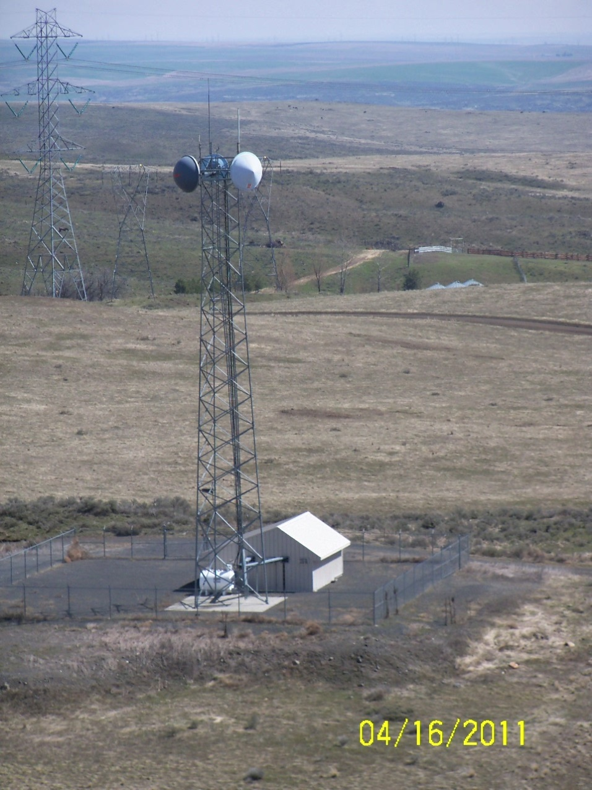
Questions?
Bob Schwent
Robert.Schwent@wsp.wa.gov
(360) 534-0601

Slide 28
Ongoing Projects:
Washington State Military Department Emergency Management Division
Matthew Modarelli
Robert Ezelle

Slide 29
Ongoing Projects:
800 MHz Rebanding Project,
SAW Briefing Paper
Michael Marusich

Slide 30
Good of the Order
Next Meeting: August 18, 2016
Location:
Building 92, Rooms 1 & 3
Camp Murray

