Slide 1
Broadband 101 – History + Data
Fall 2019

Slide 2
A short history 1996 to present
Broadband data, development, and expectations over time

Slide 3
1996 – K-20 Network
The K-20 Educational Network is a statewide large-scale and high-speed intranet and is also the conduit for Internet services for education institutions across Washington State.
The State Legislature created the K-20 Network in 1996 for several purposes: to use technology to educate, to teach students how to use technology, and to connect Washington’s educational institutions.
The network includes a 100 gigabit dense wave division multiplexing backbone and over 400 Ethernet tail circuits providing from 100 megabits two 2 gigabits of broadband to higher education, community college and K-12 institutions statewide.

Slide 4
BTOP era 2009-14
Federal Grants and loans
Broadband Technology Opportunity Program (BTOP / CFDA 11.557)
NoaNet $130 million
Pend Oreille PUD $27 million
Toledo Tel $2 million
EdLab $8 million
State Broadband Initiative (SBI / CFDA 11.558)
WA Dept. of Commerce $7 million
Broadband Initiatives Program (BIP / CFDA 10.787)
Okanogan PUD $5 million
Ecliptixnet $14 million

Slide 5
Stakeholder Recommendations - 2012
In 2012 a diverse group representing industry, government, academia and nonprofits made a set of concensus broadband policy recommendations to the legislature. The recommendations are available from the State Archives in the 2012 Broadband Report. Here are the council's recommendations in three buckets: Workforce, Strategies, and Infrastructure
Adopt Digital Best Practice in government
Enable a 21st century work strategy
Continue leadership in digital education
Encourage public-private partnerships
Expand local technology planning teams
Promote public safety
Training along with infrastructure
Streamline permitting process
Reduce duplicate trenching

Slide 6
2012-13: Broadband Action Teams funded
One of the ways the State Broadband Office used its federal funding was to pass support through to “Local Technology Planning Teams” in places like:
Klickitat and Skamania counties
Stevens county
Lincoln County
Clallam and Jefferson counties
Clarkston
Walla Walla

Slide 7
2015: Public Safety’s wireless network
Washington’s OneNet program was established as a partner to the First Responder Network Authority (FirstNet).
FirstNet was tasked to build a truly nationwide public safety broadband Network (NPSBN) and bring interoperable wireless broadband communication to emergency responders.
In 2016 Washington “opted in” to the ATT-operated network built for FristNet

Slide 8
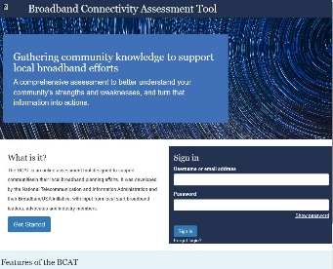
2016: Community Connectivity Initiative
Not funding – just a framework
Standard questions for project applications
Access alone is not enough for sustainable results

Slide 9
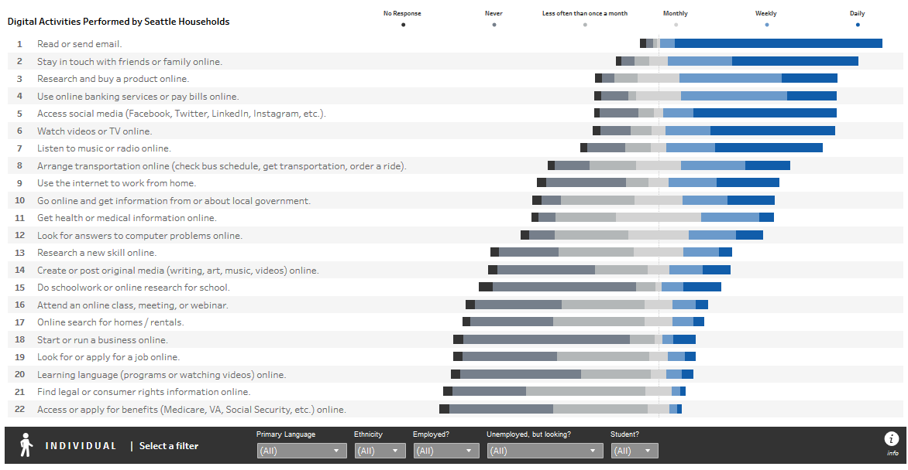
Digital Skills
Seattle tech survey says Seattleites are doing thiese things online:
Work from home (telework)
Monitor government (open data)
Get health info
Learn a new skill (lifelong learning)
Schoolwork / homework
Start/run a business
Apply for a job
Apply for benefits

Slide 10
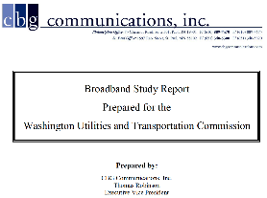
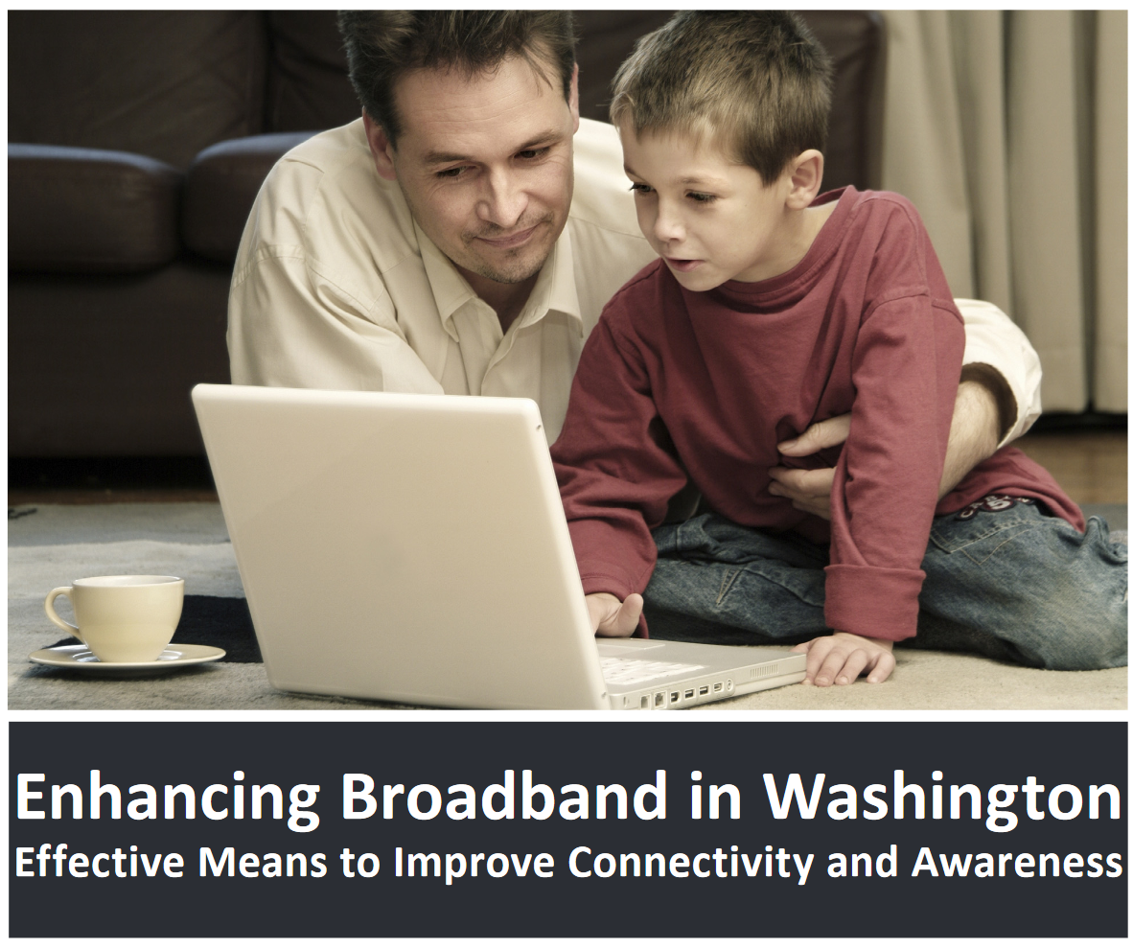
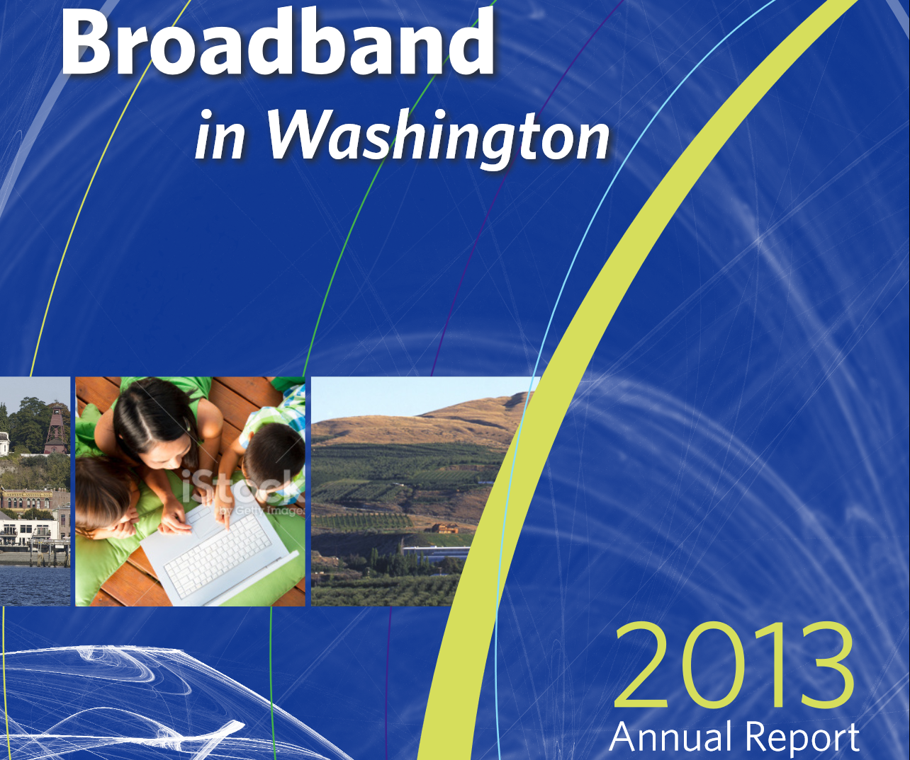
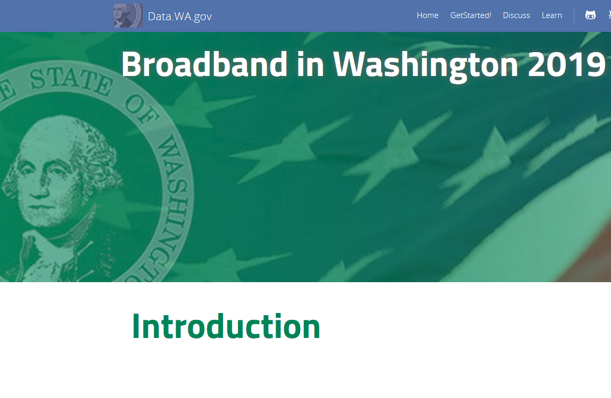
2008 (UTC)
2009
(GOV)
2010
2011
(DIS)
2012
(COM)
2013
(COM)
2014
2015
2016
2017
2018
2019
(OPDP)
2020
Broadband Reports
All the images below are links
All reports are in the state library

Slide 11
Where do we stand now?
Where Washington Ranks nationally
Data from FCC 2016 report,
Akamai State of the Internet

Slide 12
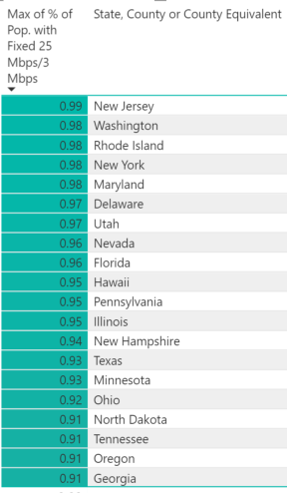
2nd best by % population with access at 25 Mbps
FCC data from 2018 report assessing percentage of population lacking access to broadband at then-current broadband speed
Up from 7th in 2016 after a change in methodology at the FCC
Data from the FCC Broadband Deployment Report, Appendix F, processed with PowerBI

Slide 13
Over 90% 4G mobile
Over 90% of WA census blocks have multiple providers of 4G LTE
… according to data from FCC as of June 2018
Visualization from Internet-is-Infrastructure

Slide 14
Data Problem #1 – imprecision
FCC maps neighborhoods
People live in homes

Slide 15
Problem #2 – stats don’t match the citizen experience
FCC: all of WA above 25 mbps
Speed tests: 50% of WA below 28mbps

Slide 16
Problem #3 – technology-focused, not service-focused
Fixed – DSL/Cable/Fiber/Wireless
Mobile – 4G LTE

Slide 17
Microsoft maps the gap
Microsoft has studied the broadband access data published by the FCC, and compared it to data on internet use obtained by the company independently.
Microsoft's conclusions are especially significant for Ferry County, one of Washington's most rural areas.
This analysis shows that while FCC data indicate 100% of Ferry County residents have access to broadband, Microsoft data show only 2.2% are using broadband speeds to reach the internet.

Slide 18
Speed Tests - Peers
mLab is an open database of speed test results from around the world
Washington results (red) are about even with the national average (magenta)
Massachusetts (pink) is noticeably faster
Idaho (black) is noticeably slower
Speed tests show what the user experiences on their particular computer or phone, which may be misconfigured or just swamped with Fortnite gamers.

Slide 19
Urban / Rural divide (excluding Satellite service)
About twice as many “rural” residents are unserved compared to “metro” residents
Fewer rural residents have a choice of providers
Data from the FCC, visualization from Internet-is-Infrastructure

Slide 20
Actual places

Slide 21
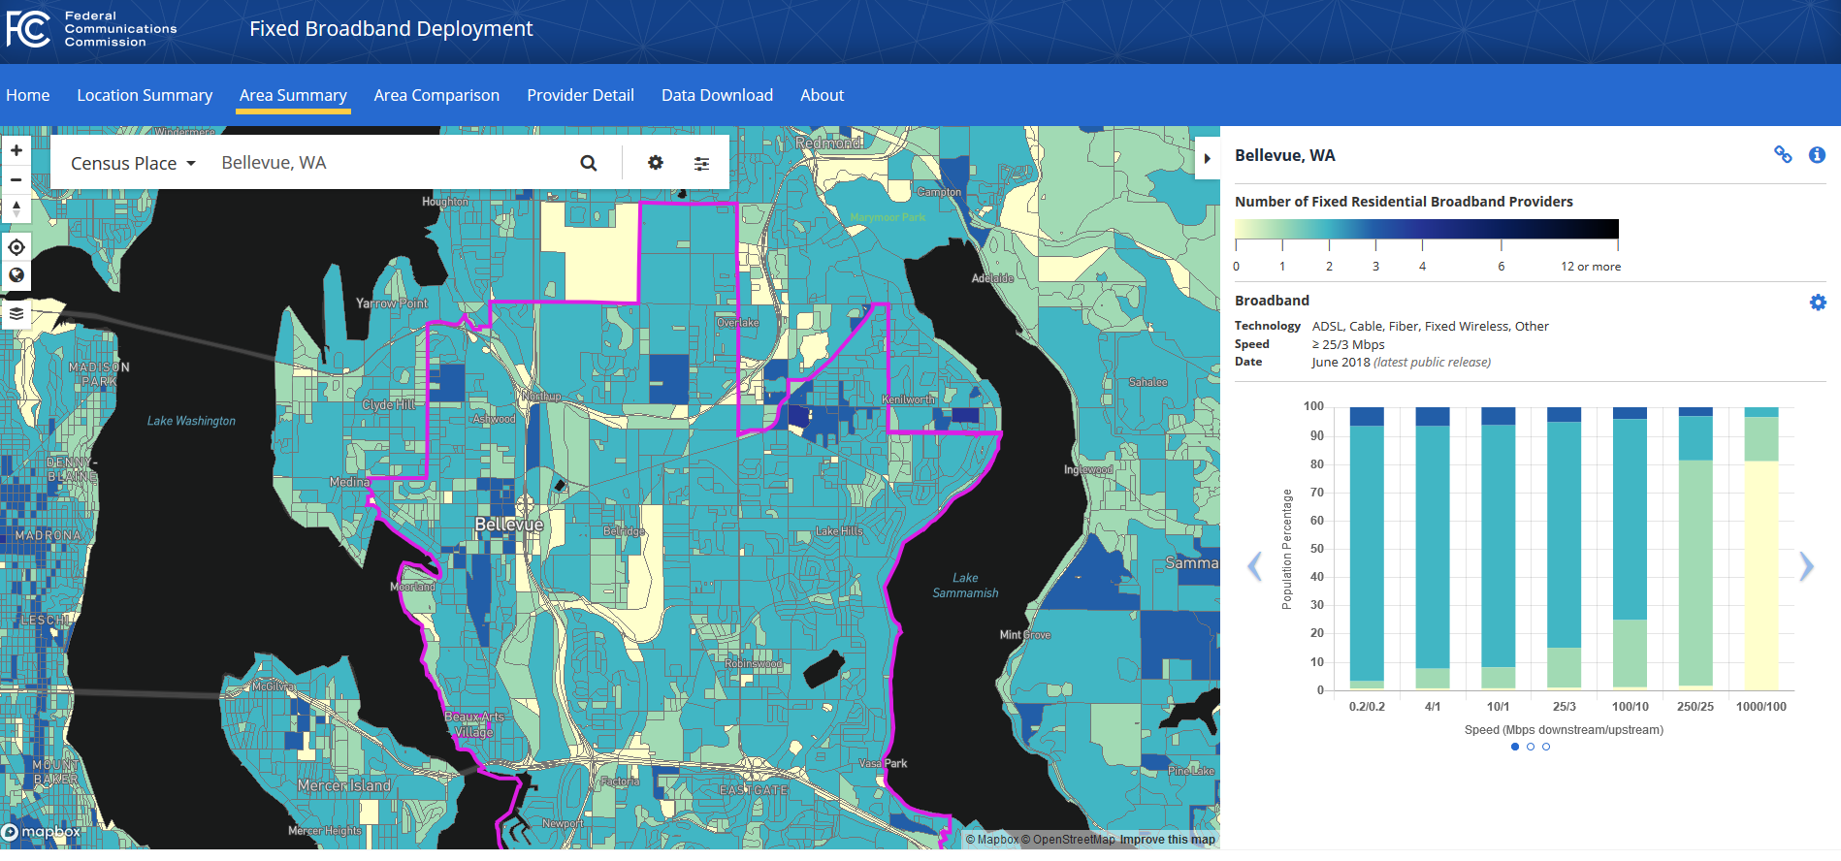
Bellevue: Multiple Providers of very fast service
Including Satellite service

Slide 22
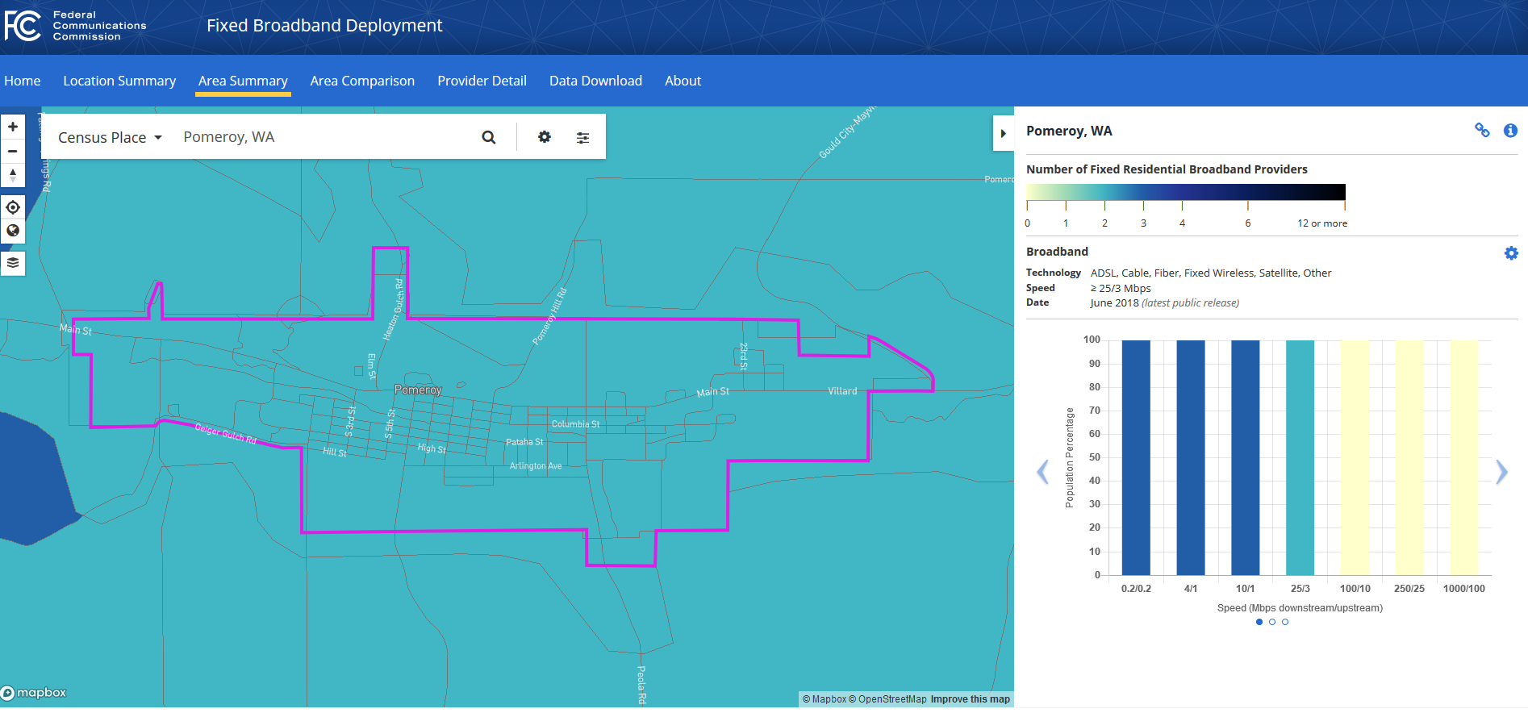
Pomeroy – 10 megabits or satellite
Including Satellite service

Slide 23
Chewelah: at least 2 providers at 100 mbps

Slide 24
Where’s the rest of the data?
Where to find broadband data, including:
Open data on Data.wa.gov, FCC maps and data, Reports in the State Archive
Images marked with this symbol are hyperlinks to online resources
Selected communities in Washington State

Slide 25
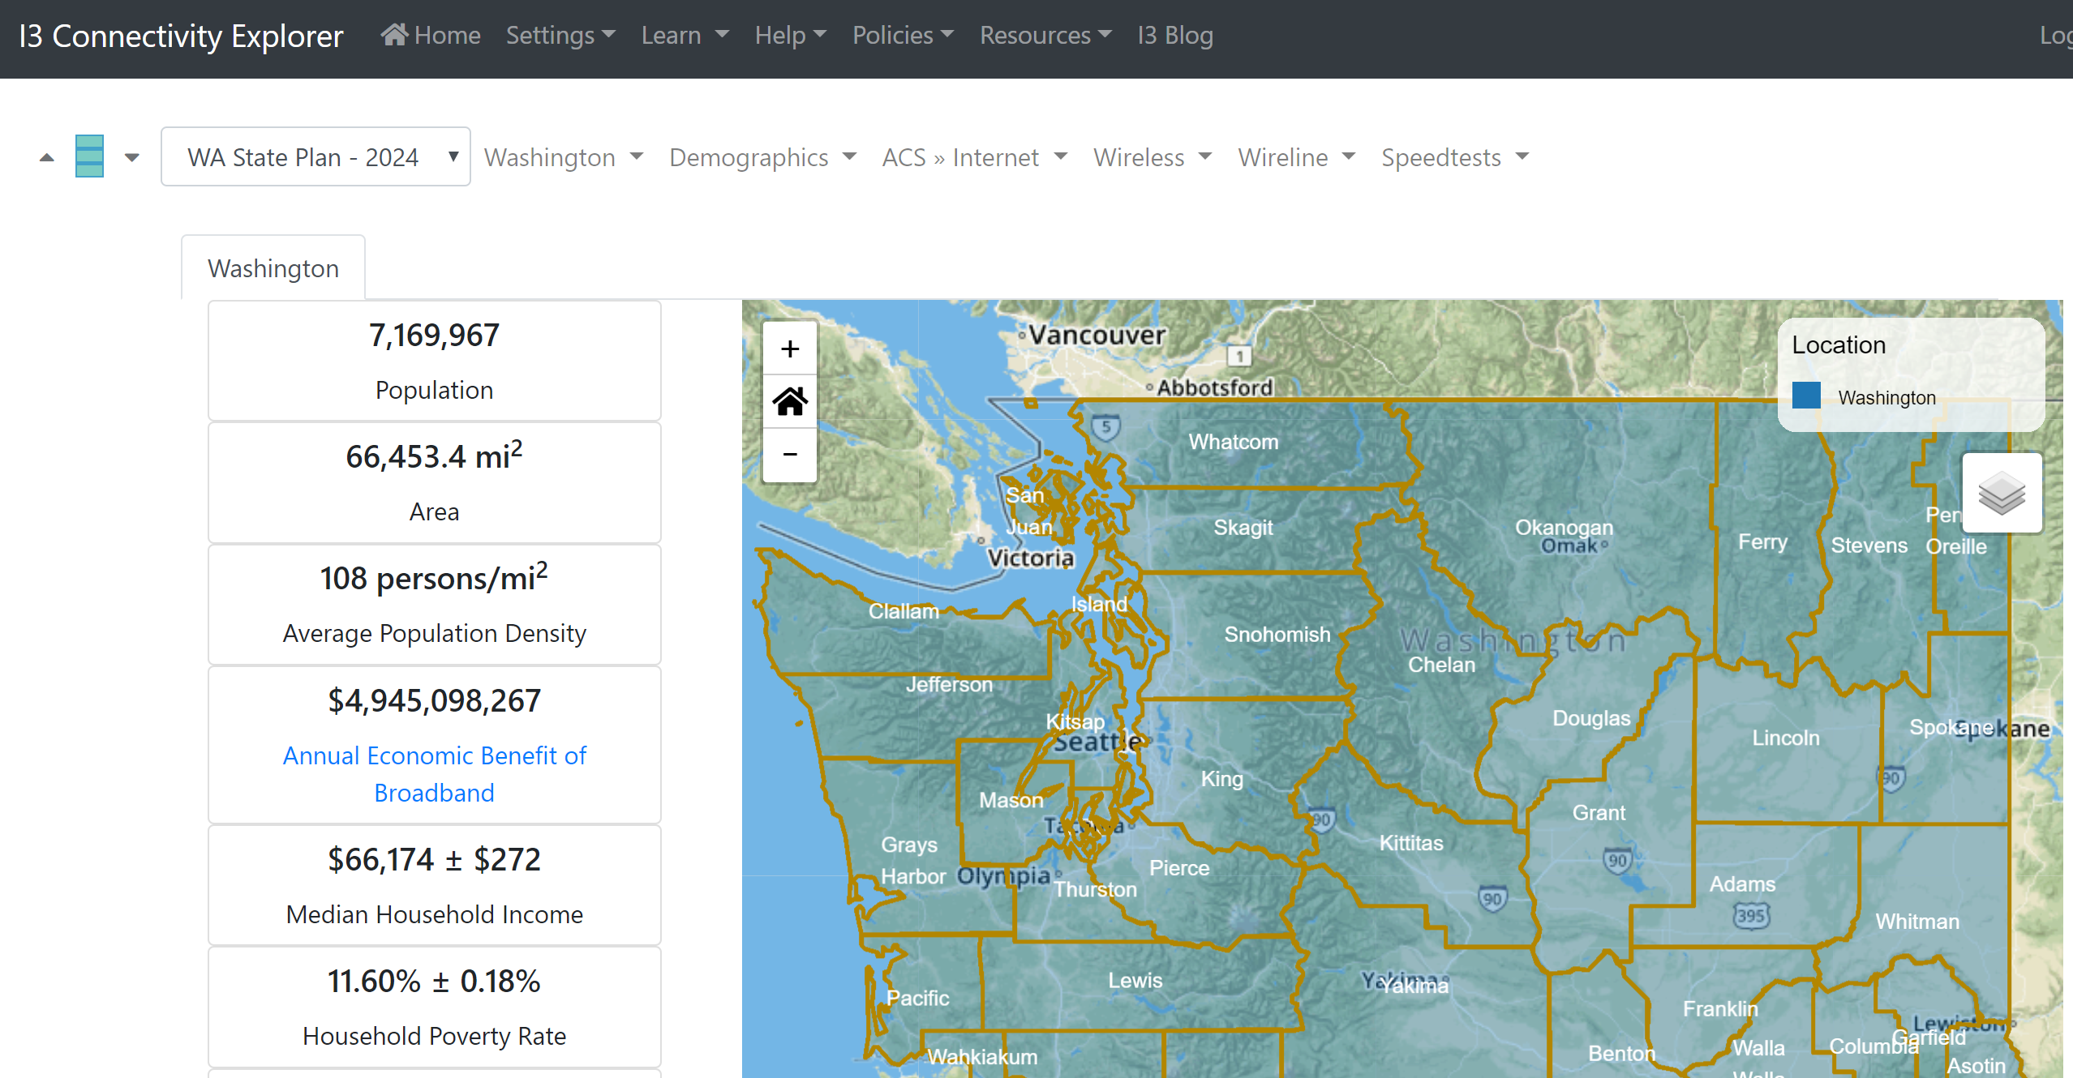
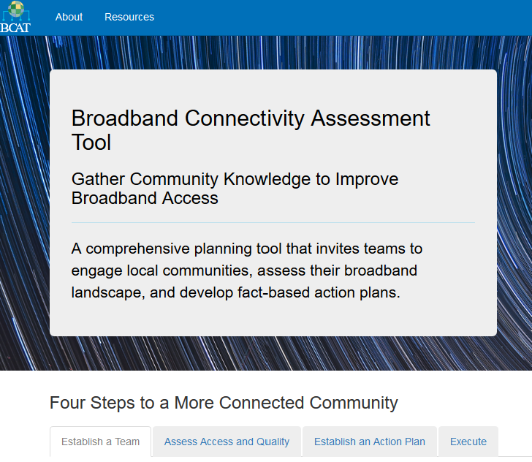
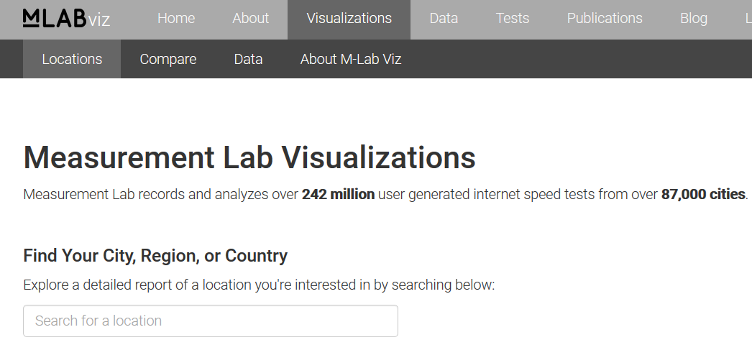
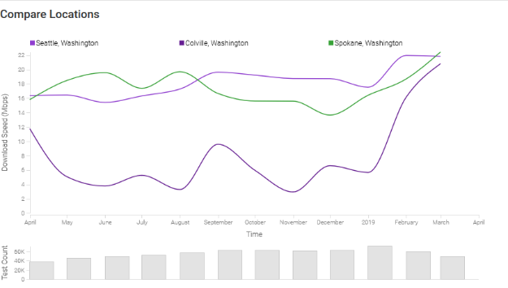
Free and civic tools
Some broadband datasets are so large that they need to be carefully filtered or configured in order to work and make sense

Slide 26
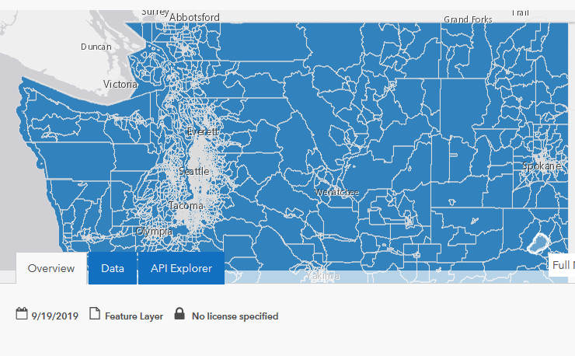
Open Data: data.wa.gov/geo.wa.gov
FCC 477 wired and wireless data for the NW (WA, OR, ID)
USAC data on addresses benefiting from CAF
Community anchor institution lists
Speed test data from Ookla for 2010-2014 by address
Population by census block
Parcels
School technology survey

Slide 27
Licensed Data: Fiber, Towers, CaTV
Some data are much easier to buy than to assemble. These include multiple provider locations of things like fiber optics, Cable TV Service areas

Slide 28
What we don’t know
Price of competitive services in the marketplace
Local service speed increases

Slide 29
Recommendations

Slide 30
Using federal programs
FCC
E-Rate: discounted service for schools and libraries
Connect America Fund: location-based support direct to providers
Lifeline: discounted service for low income subscribers
Rural Healthcare: equipment
USDA
Community Connect: unserved areas
Rural Broadband Access Loans
Distance Learning / Telemedicine DLT
ReConnect
EDA – various programs

Slide 31
Best Practices – lessons from history
Measure what matters
If you care about broadband at home, don’t settle for measuring it in the neighborhood
If you care about citizen satisfaction, listen to the complaints
Whatever you do, Promote the positive
Broadband is local
What works for Sequim may not work for Washtucna
Olympia is not the Oracle
Local residents, local solutions
Does your legislator’s office have broadband info?

Slide 32
Thank you
Wilford “Will” Saunders
Office of the State CIO (OCIO)
will.saunders@ocio.wa.gov

Slide 33
Beyond the basics
A deeper dive into the data

Slide 34
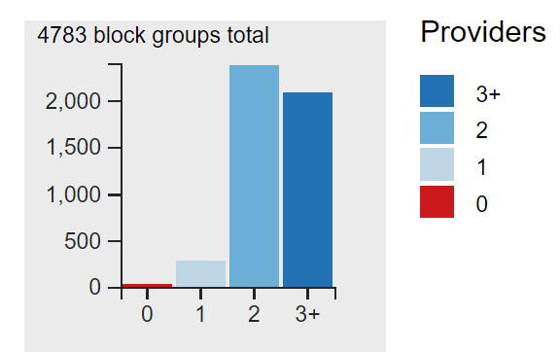
Fixed Service at 25 mbps
Census Block Groups
Residents of “metropolitan” census blocks
2.7% are unserved
28.6% have 3+ options (“well served”)
68.7% have only 1 or 2 options
Residents of “rural” census blocks
16.4% are unserved
4.9% have 3+ options (“well served”)
78.7% have only 1 or 2 options
All but about 50 census block groups have access to broadband from at least one provider at or above 25 megabits download

Slide 35
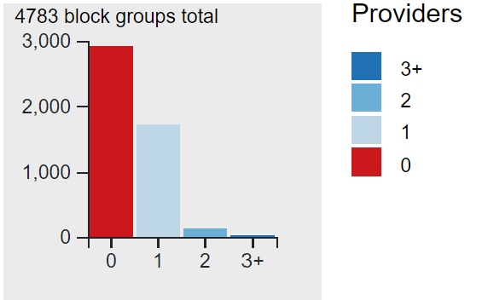
Fixed service at 150Mbps upload and download
If we slide the scale a bit to look at people with access to 150mbps download and upload (the state’s 2028 goal) then the picture looks very different
No Washingontians currently have 3+ choices at these speeds
Metro residents
80.7% are unserved
19.2% have 1-2 options
Rural residents
80.1% are unserved
19.9% have 1-2 options

Slide 36
Rural/urban Disparity top 10
FCC data from 2016, highlighting counties with large disparities between urban and rural populations without access.
100% of Garfield county’s rural population is reported to lack access to broadband
Pend Oreille county has over 80% of its rural population unserved and about 80% of its urban population unserved.

Slide 37
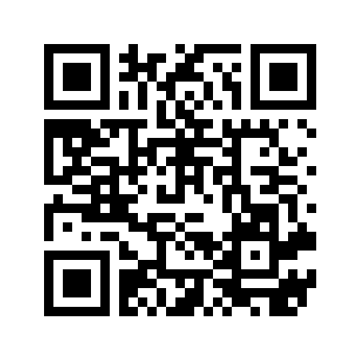
Roll-your-own data…
http://privacy.wa.gov/broadband-data

Slide 38
Visuals from 2016

Slide 39
Rural Broadband Adoption
From UTC, NTIA, FCC studies

Slide 40
Adoption over time
In 2007 the UTC studied broadband availability and adoption in 5 rural counties:
“32% of total residents in the five studied counties have wireline broadband services”
In 2011 the NTIA studied rural and urban broadband adoption across the country
68% of rural households have broadband
In 2018 FCC reports 98.30% of rural residents have access to broadband

Slide 41
Broadband expansion grant funds
From an NTIA scan of State-sponsored broadband programs in 2016

Slide 42
Data in context: more community snapshots
Selected communities in Washington State (alphabetical order)
With data from the FCC, BroadbandNow, Root metrics and others
Most images are also linked to the source data.

Slide 43
Bellevue in 2016
Broadbandnow: 2 with fiber
FCC: Multiple providers

Slide 44
Chewelah in 2016
FCC: East side served
Broadband now: multiple modes

Slide 45
Aberdeen
FCC: Only Comcast >25 megs
Root metrics: spotty mobile

Slide 46
Chewelah
FCC: East side served
Broadband now: multiple modes

Slide 47
Ephrata
Fiber, dsl, cable, wireless
Wireless @ 49mbps 5-star fiber

Slide 48
Long Beach
FCC: Only one >25 megs
Broadband Now: price / speed

Slide 49
Mt. Vernon
FCC: DSL + Cable + Wireless
Broadband now: major players, minor prices

Slide 50
Pomeroy
Fcc: fully served
Broadbandnow: 25mbps $170

Slide 51
Toledo
FCC: one provider, fast fiber
BroadbandNow: 5-star gigabit

Slide 52
Bremerton
FCC: downtown gaps
Broadband Now: 3 majors

Slide 53
Neah Bay
FCC: tribal lands unserved
BroadbandNow: Wireless gig @ $170

Slide 54
14% of Rural population unserved; 1% urban
FCC data from 2016 report assessing percentage of population lacking access to broadband at then-current broadband speed

