Slide 1
Technology Services Board Quarterly Meeting
December 8, 2020

Slide 2
Agenda
TOPIC | LEAD | PURPOSE | TIME
Welcome and Introductions | Jim Weaver | Introductions | 9:00
Approve Minutes from Sept 8 Meeting | Jim Weaver | Approval | 9:04
State IT Strategic Plan Update | Sue Langen | Strategy Update | 9:05
Enterprise Architecture Program | Sue Langen Dan Mercer | Alignment with Strategy | 9:35
Public Comment |  |  | 10:05
Executive Session for Members and Select Staff Only – Closed to public | Jim Weaver |  | 10:06

Slide 3
Current TSB Members
Industry Members Butch Leonardson – Retired CIO Paul Moulton – Costco | Legislative Members Rep. Matt Boehnke – House R Rep. Zack Hudgins - House D Sen. Patty Kuderer – Senate D Sen. Ann Rivers – Senate R
Executive Branch (Agency Directors) Jim Weaver – State CIO & Chair David Danner – UTC Tracy Guerin – DRS Vikki Smith – DOR | Other Government Viggo Forde – Snohomish County
Members present
Members absent

Slide 4
Do you know about the new WA Notify app?
Go to WANotify.org for more information

Slide 5
Welcome/Introductions
Approve 09/08/2020 Minutes

Slide 6
State IT Strategic Plan Update
Sue Langen, Deputy Director for Strategy & Management

Slide 7
Inputs to Plan
Governor Priorities
Enterprise Technology Strategic Plan
TSB as advisor
Input from Agencies
CIO Priorities

Slide 8
What’s Different from Current Plan?
Goals
No changes from 2017 – 2021 Plan
Objectives
Minor changes
Priority Initiatives
New!
Measures
Pending

Slide 9
Discussion
Missing elements?
What about big data/analytics?
Overall privacy safeguards for data/exchange of data
Change framing?
Reference specific initiatives or frame around desired outcomes?
Technology or business trends to anticipate?
Post-COVID
Other?

Slide 10
OCIO Enterprise Architecture (EA) Program
Dan Mercer, State Chief Architect

Slide 11
Agenda
Overview
Challenges and Opportunities
Solution: EA Program Reform
Implementation Plan
Summary
Discussion

Slide 12
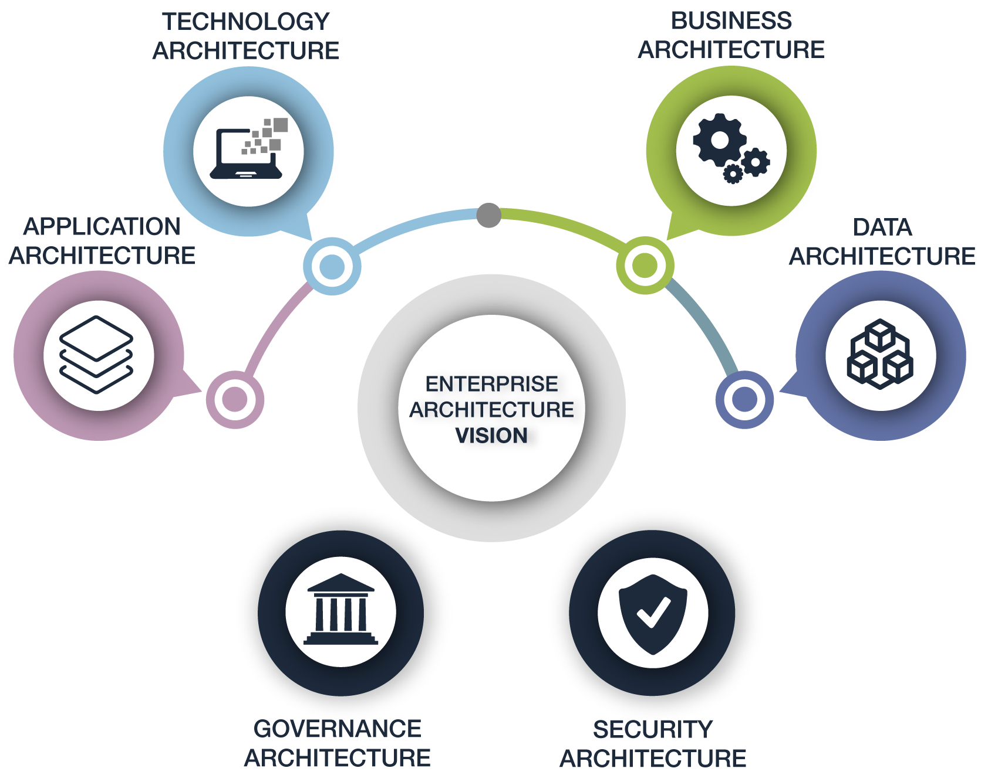
Overview: What is Enterprise Architecture (EA)?
RCW 43.105.20 (5)
(EA) is an ongoing activity for translating business vision and strategy into effective enterprise change… (EA) creates, communicates, and improves the key principles and models that describe the enterprise's future state and enable its evolution.

Slide 13
Overview: Biggest Drivers for Enterprise Architecture
Business / Technology Impact Analysis
Understanding impact of change before the change happens
Application Portfolio Rationalization
Reducing wasteful duplication, saving money, improving efficiency
Roadmaps for Digital Transformation
Planning how new technologies and innovations will enable the digital transformation of government services
Business Capability Management
Business Strategy Modeling
Conceptual and Logical Data Modeling
Integration Architecture
Improving business efficiencies and enabling new capabilities
Aligning IT investments with enterprise strategies to ensure the right projects are moving forward
Aligning information assets with business strategies, identifying unnecessary duplication and ensuring secure access and privacy
Breaking down data silos - ensuring data flows across the enterprise

Slide 14
Overview: Statutory Mandate for EA
RCW 43.105.205 and RCW 43.105.265 require the OCIO to lead and implement an ongoing enterprise architecture program for state government with the mission to:
Drive opportunities for greater enterprise efficiency;
Be the organizing standard for statewide IT;
Promote effective enterprise change; and
Improve the reliability, interoperability, and sustainability of common business processes.
Appendix C:
RCW 43.105.205 OCIO Created with EA Functions
Improve Efficiency
Manage Change
Reduce Risk
Appendix D:
RCW 43.105.265 Defines Use of EA

Slide 15
Challenges and Opportunities
The OCIO’s EA program has been an area of underinvestment, generally serving an advisory role. Most statutory requirements and benefits remain unmet. Today the state does not have robust capabilities in areas such as:
Statewide EA management – framework, models, standards and governance to communicate the enterprise’s future state and enable its evolution
Enterprise-based strategy - Criteria and roadmap for creation of enterprise services and the basis for business/technology impact analysis
Portfolio rationalization – Identifying the most strategic opportunities for modernization and reduction of duplicate systems applications
Architectural oversight of major initiatives to ensure solutions are aligned with enterprise strategy and architectural standards
Enterprise data management and integration architecture to ensure secure data flow throughout the enterprise
EA data analysis and reporting capabilities to educate and inform policymakers and strengthen decision-making
Appendix A: EA Program Primary Duties Required by RCW

Slide 16
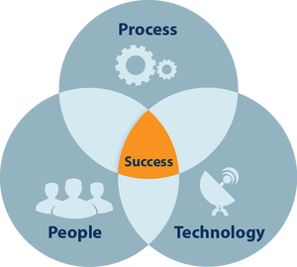
Solution: OCIO EA Program Reform
Develop Statewide Enterprise Architecture
Contract expertise to jumpstart process development
Meet statutory requirements
Focus on agility – just enough, process just in time
Develop enterprise framework, models and standards
Be the organizing standard for statewide IT
EA Tooling
Statewide data repository, analysis tools, and web portal
Portfolio rationalization capabilities
Portal available to agencies’ architects and decision-makers
EA Staffing and Expertise
Go from 3 EA positions to 9 over the next two-three years
Dedicated solution architects to major enterprise programs, like One Washington
Train staff in EA discipline

Slide 17
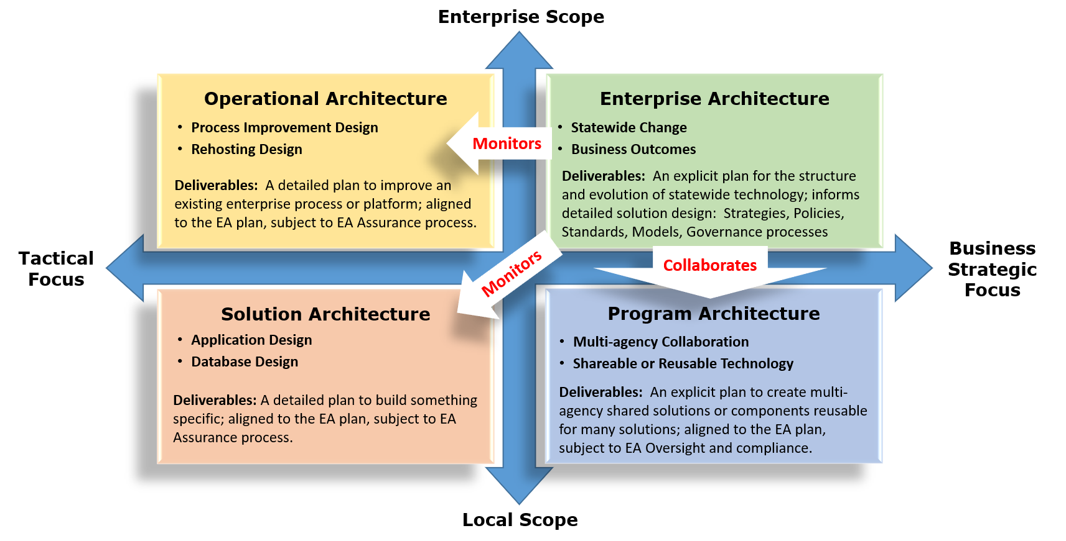
EA Team Focus: FY2021-FY2023
More than 100 major initiatives to monitor, advise and oversee at any given time
Source: Adapted from Gartner

Slide 18
Implementation Plan
Purchase and implement EA tool (in progress)
Contractor to develop EA processes and train staff (FY21)
Begin hiring additional Enterprise Architects over next three years (Planning)
Train EA and Portfolio Management staff on new EA tool and processes
Train agencies’ architects on new EA tool and processes

Slide 19
Summary
Investing in Enterprise Architecture will enable the OCIO to meet statutory obligations, help the state achieve efficiencies, effectively manage enterprise change, and reduce risk.
Short term goals include:
Deploy a purpose-built EA tool for OCIO, define data repository, upload data, define relationships, configure decision portal
Contract EA expert- Define and document the EA framework, models and processes
Define new EA positions – begin process of hiring and training new EAs.
Begin to improve the reliability, interoperability, and sustainability of IT investments by focused oversight of solution architectures for major projects and strategic initiatives including One Washington and the HHS Coalition.
Appendix B: Federal EA Framework and Tool Demo

Slide 20
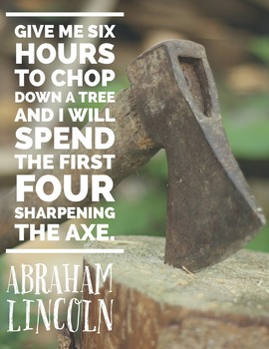
Summary
Longer term, Enterprise Architecture will help the state:
Look across all agencies and make decisions based on outcomes rather than good intentions;
Reverse the trend towards increased technical debt;
Strategically prioritize modernization efforts;
Identify common business functions that can be satisfied with a shared IT solution instead of buying the same solution multiple times;
Break down data silos, strategically integrate and ensure data flows securely across the enterprise; and
Squeeze maximum value from every IT dollar.

Slide 21
Thank You
OCIO Enterprise Architecture (EA) Program

Slide 22
Public Comment

Slide 23
Executive Session for Board Members and Select Staff Only

